Slide 1
AASHTO Load Rating of Precast Box Culverts and Pipe
Josh Beakley
January, 2016
Notes:
Load Rating is becoming very prominent in the design of box culverts these days. In fact, we are quickly coming to the point where load rating vehicles govern designs of box culverts over a typical HL93 Design. And concrete pipe is by no means immune to this issue.

Slide 2
Load Rating of “Bridges”
FHWA requires Load Rating of spans equal to or greater than 20 feet.
Some states require Load Rating of spans equal to or greater than 10 feet.
Notes:
The FHWA defines a bridge as a structure with a span of 20 feet or more. There are several states out there that have their own definition of a bridge, that is shorter than the 20 feet span.

Slide 3
Load Rating of Culverts
Bridge – “It may also include multiple pipes, where the clear distance between openings is less than half of the smaller contiguous opening.”
This is being applied to box culverts a lot lately, even before there is knowledge with regards to the specific installation
ID
L > 20 ft
CD
Notes:
The AASHTO Manual for Bridge Evaluation makes it clear that a group of culverts can constitute a bridge. So, if you have a group of pipe situated like this, where they exceed a total length of 20 feet from end-to-end, they must be load rated. This does not happen that often with pipe. However, what some states are now doing with box culverts is pre-load rating them so that if they ever get used side-by-side, they know they will load rate.

Slide 4
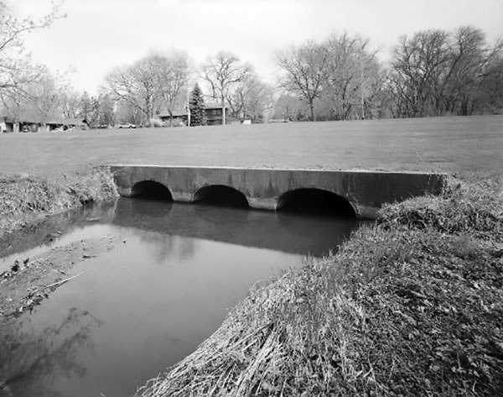
Bridge?
Notes:
You start doing things like this, and you may end up calling it a bridge. Depending on the size of the pipes and the state designation for a bridge.

Slide 5
What is Load Rating?
The AASHTO Manual For Bridge Evaluation
Governed by Subcommittee T-18, The Technical Committee for Bridge Management, Evaluation, and Rehabilitation
Notes:
Load Rating is essentially governed by FHWA policy, but when performed, follows the AASHTO Manual for Bridge Evaluation. The jurisdiction of this manual falls under the AASHTO Bridge Engineers Committee, but more specifically, the T-18 Subcommittee.

Slide 6
What is Load Rating?
The determination of the live-load carrying capacity of an existing Bridge
The rating of an older bridge for its load-carrying capacity shall be based on a recent thorough field investigation.
Section 4.3.5.9 of the MBE covers the inspection of Box Culverts as Bridges
Notes:
Load rating is the determination of the live load carrying capacity of a bridge (or structure). In many ways, it is not that difficult if you are only dealing with one or two specific loads, which hardly seems the case these days. Especially, since most box culvert design programs now perform a load rating at the same time as when they perform the design. Bridges have to be evaluated every two years to make sure they are safe, so the MBE includes an additional phi factor for the condition of the structure. The MBE explains a lot when it comes to inspecting a Bridge, it does have a small section for box culverts. Not a lot in there, and it has a small section for corrugated metal structures as well.

Slide 7
Load Rating Levels
Design Load Rating – Assesses the performance of existing structures utilizing the LRFD-Design Loading (HL-93) and Design Standards.
Legal Load Rating – Bridges that do not have sufficient capacity under the design-load rating shall be load rated for legal loads to establish the need for load posting or strengthening
Performed if the structure doesn’t have sufficient capacity under the design load rating assessment.
Permit Load Rating – Load rating the structure to determine its ability to safely carry Permit Vehicles as allowed by the state
Notes:
There are three basic levels of load rating. The second one doesn’t really concern us much, but certainly the first and third do. The culvert has to be able to support the LRFD HL-93 design load. This is not always as easy as it seems with the different design methods that are out there. The second case if for structures that can’t meet the load rating requirements for the design loads, which, if we are supplying the culverts, they better be able to. The permit load rating gets tricky, because it can involve a lot of different types of trucks/vehicles.

Slide 8
Design Load Rating
Inventory Rating – Load ratings based on the inventory level allow comparisons with the capacity for new structures and therefore, results in a live load, which can safely utilize an existing structure for an indefinite period of time.
Operating Rating – Load ratings based on the Operating rating level generally describe the maximum permissible live load to which the structure may be subjected. Allowing unlimited numbers of vehicles to use the bridge at Operating level may shorten the life of the bridge.
Notes:
The operating load rating allows higher loads via lower load factors based on the assumption that these loads do not occur that often, and the bridge/structure should be capable of handling them every once-in-awhile.

Slide 9
Do We Need to Perform A Load Rating for a New Culvert?
The Manual for Bridge Evaluation, 2nd Edit. – C 6a.1.1
“Bridges will have adequate capacity for all AASHTO legal loads and State legal loads that fall within the exclusion limits described in the AASHTO LRFD Bridge Design Specifications if the design and assigned ratings are based on HL-93. Load rating calculations would be necessary if the
force effects from state legal loads or
permit load exceed those from the design
loading.”
Notes:
This is where you get in trouble. The MBE tells you that if you design a bridge for HL-93, than it is good for the design load rating. No problem. You can give them ratings of 1.0 and 1.3 right off the bat. However, if a state has legal or permit loads that are higher than design, you will need to run load rating calculations. And these days, what state doesn’t have legal or permit loads above the AASHTO design loads.

Slide 10
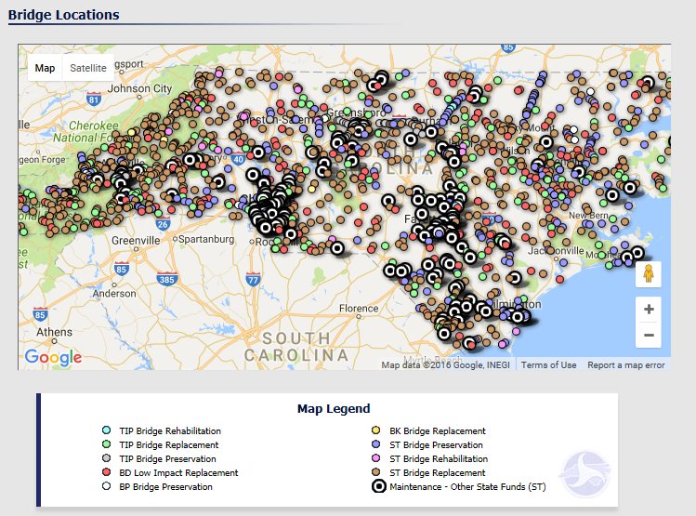
We Need to Help Our Customers
Notes:
I came across this picture and decided to put it into my presentation to emphasize one thing. Our customers, the DOT’s, have an awful lot of bridges to worry about. If are structure is going to be considered to be bridge worthy, and we can help them by providing a quality product that will load rate to whatever needs they have, then it is prudent that we do.

Slide 11
Notes:
I stole this slide from an FHWA webinar back in 2011. It gives you the basic load rating equation. You are taking the capacity of the structure, and subtracting out how much of that capacity is utilized in carrying the dead loads, earth loads, and fluid loads, and taking the remainder of the capacity and dividing it by the capacity needed to support the live loads. If the ratio is 1 or greater, than it means the structure has enough capacity to support the live loads. If it is less than one, than you do not have adequate strength in the structure, and you must post it for lower live loads than what is typically allowed on a highway.

Slide 12
How Much Detail Should be Put into Analyzing the Culvert?
Notes:
This is where it gets tricky. “The analysis of the box culvert may be based on any rational method acceptable to the owner”. Different owners have different ideas on how to analyze a box culvert.

Slide 13
Notes:
I stole this slide from an FHWA Webinar that was presented back in 2011. It pretty much sums up what the agencies get stuck with when it comes to rating an existing culvert. It starts with analyzing it with something simple in the hopes that this is enough to prove the structure is acceptable. If this doesn’t work, then they have to go to more refined methods to try to keep from posting the bridge/structure. Thus, you can see that ideally, when the culvert is first supplied, they want the design to be relatively simple, and performed in a simplified manner, so that they don’t have to go to refined methods in the future unless the culvert experiences deterioration.

Slide 14
C6A.5.12.3
A common yet conservative approach is to use a two-dimensional frame model by taking a 1.0-ft wide slice normal to the culvert flowline.
The following assumptions can be made:
A 1.0-ft section of the culvert may be analyzed as a frame
The frame has a pinned support at one end and a pin-roller support at the opposite end.
Gross section properties are used for strength ratings
Supporting soil pressures are uniform over the length of the bottom slab
Vertical loading is balanced by bottom slabs with no reaction at the supports.
No hydrostatic pressure (water) exists inside the culvert
Supporting soils are fully drained, i.e. no hydrostatic pressure outside the culvert
Notes:
These are suggestions found in the MBE for the design/load rating of box culverts. Basically, keep it simple.

Slide 15
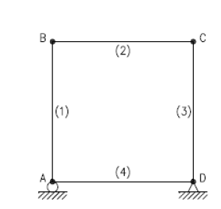
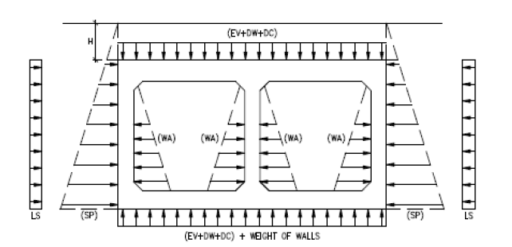
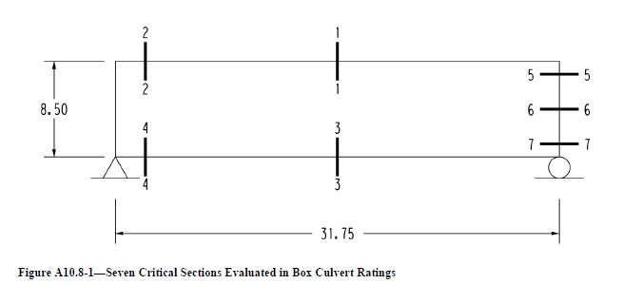
ET Culvert
MBE Example
Notes:
This is the frame analysis that ETCulvert performs. It meets all the suggestions mentioned in the previous slide, although there are some additional loading details that can be added if needed.
The MBE has an example load rating problem for box culverts. This bottom figure shows the frame analysis from the program that they used. Same thing. The details you do not get, is how they incorporate the effect of the haunches, if at all. The MBE example shows the critical sections for evaluation. The top and bottom slabs have symmetric loading, so you only have to check one end of the slab. The lateral pressures are not, so you must check the top and bottom portions of the wall, as well as the midpoint.

Slide 16
6A.5.12.2
“Culvert Structures shall be evaluated for flexure, shear, and axial thrust.”
Previous….”Culvert ratings should recognize that these structures experience several loadings that are not applicable to most bridge superstructures , including vertical and horizontal soil loads, and live load surcharge.”
Thrust is part of the design.
Notes:
As small, and simple as they are in comparison to large span bridges, box culverts still have some unique qualities that must be considered in their design/load rating. The MBE makes it clear that thrust needs to be considered, but does not give much further guidance than this.

Slide 17
Notes:
The example in the MBE shows that thrust was calculated, but they do very little with the value when they determine the capacity of the structure.

Slide 18
LRFD Culvert Design
LRFD Culvert Design
LRFR Culvert Rating
12.5.2 - Service Limit State
Service Load Combination I
12.5.3 - Strength Limit State
Strength Load combinations I and II
12.5.2 - Service Limit State
Service Load Combination I
12.5.3 - Strength Limit State
Strength Load combinations I and II
For Design and Legal Loads
Strength Load combination II
For Permit Loads
Notes:
When performing load rating, you basically utilize the same design method as if you were designing the culvert. However, you do not need to evaluate service load levels (crack control).

Slide 19
Load Factors
AASHTO LRFD Bridge Design Specifications
AASHTO Manual for Bridge Evaluation
DC – 1.25
DW – 1.5
LL – 1.75
LS – 1.75
EH – 1.35
EV – 1.3
ES – 1.5
DC – 1.25
DW – 1.5
LL – 1.75
LS – 1.75
EH – 1.35
EV – 1.3
ES – 1.5
Notes:
Thus, as long as you are performing a load rating for design loads, all of your factors stay the same. That wasn’t always the case. When we get to permit vehicles, the load rating factors change. These vehicles are only rarely seen on the structure, and are better controlled through the permitting process, so the live load factors can be reduced a little.

Slide 20
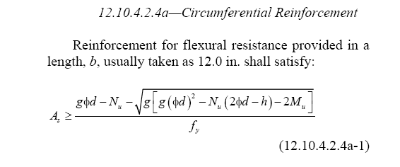
Thrust Included
0.85*f`_{c}*b*a
a = β₁*C
Nu
Mu
A_{s}f_{y}
Notes:
So you apply the loads on the structure, and analyze it to determine the moments, shears, and thrusts, as discussed. Then you have to evaluate these forces with respect to the actual capacity of the structure. The “C” in the equation. This is another area that gets tricky. The thrust forces in a reinforced concrete member can actually reduce the amount of reinforcement needed in the structure. But many agencies either choose to ignore this beneficial force, which is does exist, and is not an optional force, or sometimes they go all the way, and design the member as if it is a column primarily resisting axial force, and not a beam primarily resisting bending moments.

Slide 21
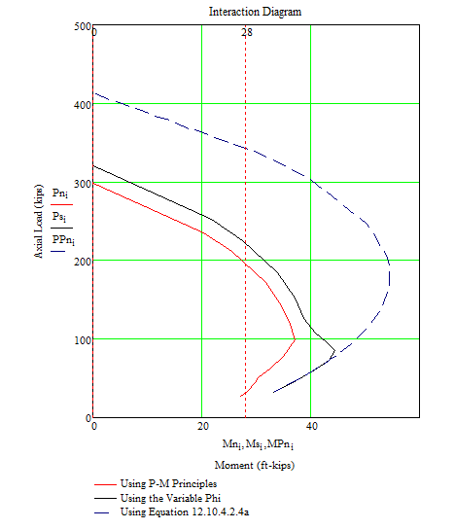
Capacity Options Abound
Notes:
Thus, there are so many options on how to determine the capacity of the slabs and walls in a box culvert, that you never know what option the agency might use. In this example, if you use a simple equation for bending moment only, you get the straight line. This is how the MBE example does it. They acknowledge the thrust, but determine that it is low enough that they can conservatively use the bending equation alone. If the thrust had been more than 10 percent of the total axial capacity, then they probably would have used the interaction approach, designing the element as more of a column. Design of flexural members in Section 5 of the AASHTO LRFD Bridge Design Specifications utilize a variable phi factor in the capacity, so that once the member becomes compression controlled, the phi factor reduces. Equation 12.10.4.2.4a, which is what we have used for boxes and pipe for many years, uses a static phi factor of 1.0, and thus, you do not see the effects of the member being compression controlled in the graph. However, in actuality, we don’t allow fully compression controlled members, so most of this graph does not apply to us anyway. The key point here is that there are a lot of methods for determining the capacity of a box culvert that do not give the same results as the design method that may have been used to design the original box. ASTM C1577 boxes were all designed using Equation 12.10.4.2.4a.

Slide 22
Latest Change in the LRFD Bridge Code
Notes:
The discrepancies from the different methods of determining the capacity of the elements has been an issue for awhile now. One of the big problems is that Equation 12.10.4.2.4a is found in the pipe design section of the AASHTO LRFD Bridge Design Specifications, and engineers were hesitant to apply it to box culverts, even though it is based on engineering principles of reinforced concrete and is not specific to pipe. This past year, AASHTO adopted additional language in Section 12 making it clear that this equation could be applied to boxes.

Slide 23
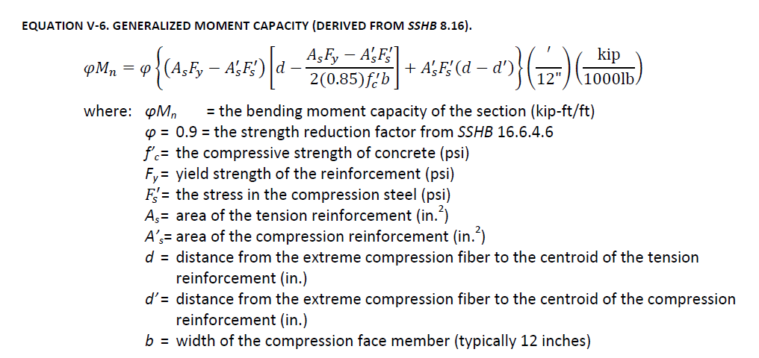
August 2009
Texas Tech University
William D. Lawson
Timothy A. Wood
Charles D. Newhouse
Priyantha W. Jayawickrama
SSHB – Standard Specification for Highway Bridges, 2002
Notes:
A few years back when TXDOT had Texas Tech look into how to load rate box culverts, they considered the compressive steel reinforcement, as well as the tension reinforcement. Another option for getting more capacity out of the element. Although, with the depth of precast members this usually isn’t that big.

Slide 24
Notes:
If you get desperate, then you can utilize more advanced analysis tools, as well as modifying the way you calculate the capacity of the structure. But remember, that as an industry, this is not where we are supposed to be. We should be performing the simplified frame analysis and making sure everything works from the get-go. This should be for older culverts.

Slide 25
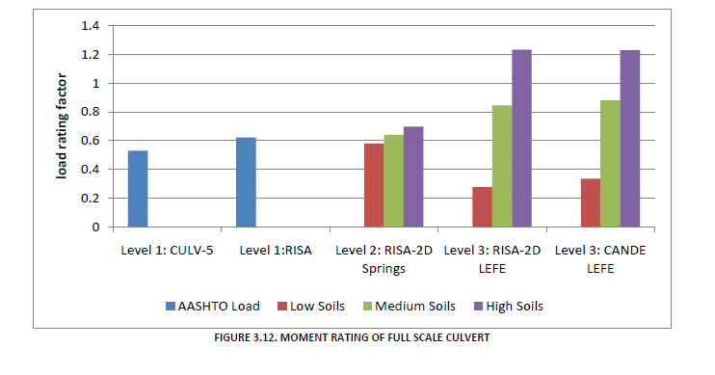
“Evaluating Existing Culverts for Load Capacity Allowing for Soil Structure Interaction”
Texas Tech University; William D. Lawson, Timothy A. Wood, Charles D. Newhouse,
Priyantha W. Jayawickrama
http://www.depts.ttu.edu/techmrtweb/Reports/Complete%20Reports/TxDOT%200-5849%20Research%20ReportFINAL.pdf
Notes:
This gives you an idea of what can be accomplished when you try various options for the load rating of a box culvert.

Slide 26
Load Rating Pipe?
Notes:
Some of these issues only get more complicated if you ever have to load rate pipe. Remember, that we shouldn’t be load rating pipe unless there are several pipes laid very closely together.

Slide 27
Load Rating with the Indirect Design Method?
(
1.3 W_{e}
1.0 W_{f}
)
1
D_{ult} -
+
B_{fe}
B_{fe}
ID
INVRF =
(
)
mpf
(1.75 )W_{L}
B_{fLL} * ID
Notes:
If you ever need to load rate a pipe. This is the basic equation we have come up with for load rating a pipe that utilized the indirect design method. Remember, we are looking at the ultimate load, and not service/crack load.

Slide 28
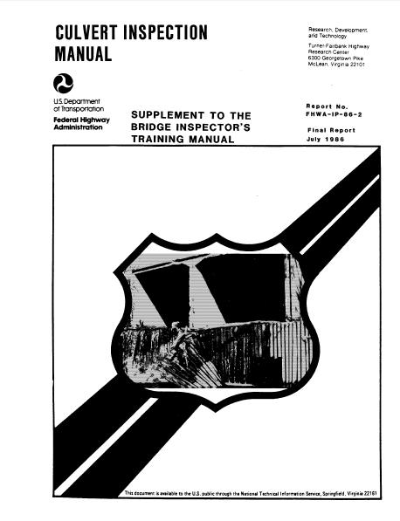
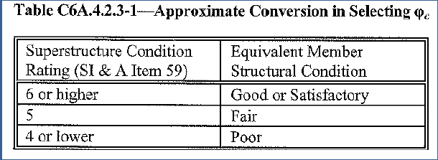
Condition Factor?
Notes:
As I mentioned, as producers, we are supplying a new product, so it better be in good condition, Thus, in terms of having a condition factor, that phi factor should be 1.0. However, if we want to help our agency friends out with load rating existing culverts, the condition factor gets harder to define. The MBE has guidance for condition factors for bridges, and even relates them to their rating from the bridge inspection. The Feds just updated the Culvert Inspection Manual, through an NCHRP Research project, but no such correlation to a condition factor was addressed unfortunately.

Slide 29
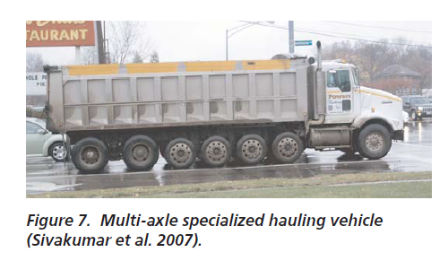
What Are We Load Rating?
Notes:
So, if things weren’t complicated enough, very seldom is the load rating for the HL-93 Design Loads the governing criteria. There is usually, some sort of specialized hauling vehicle, or permit load in each state that tends to govern the load ratings, which in essence governs the initial design of your box culvert structure.

Slide 30
Legislatures only Make Things Worse
FAST Act
Allows Exemptions in truck weights for:
Fluid Milk Trucks
Heavy Duty Tow Vehicles
Emergency Vehicles
Trucks that run on natural gas
FHWA estimates that approximately 10% of existing bridges in the nation will need to be posted for weight limits on these vehicles
Separate signs may need to be developed – AASHTO SCOBS, June, 2016
Notes:
There have been some new things with the latest Highway Bill that made things even trickier. When they passed the FAST Act, they allowed exemptions in truck weights, which means there will now be heavier trucks allowed than perhaps what is considered in AASHTO. FHWA estimated that 10% of bridges will need to be posted for these vehicles. Back in June, they were even contemplating whether or not they would need to develop specific signs for these vehicles.

Slide 31
Feds have put out the Memo.
November 3, 2016
Two Emergency Vehicle Configurations can be used to envelope typical emergency vehicles
EV2
Single Front Axle of 24,000 lbs
Single Rear Axle of 33,500 lbs
Wheelbase = 15 ft
EV3
Front Single Axle of 24,000 lbs
Rear Tandem Axles spaced 4 feet apart – 31,000 lbs each
Wheelbase = 17 – From center of front axle to Tandem Center
Notes:
The FHWA has been taking a look at this, and they recently came out with a memo on November 3rd, explaining to the states how they should evaluate Emergency Vehicles. They developed two emergency vehicles that must be evaluated. If you are familiar with the HL-93 loads, than you can compare the single axle and tandem axle loads and see here just what the states are up against.

Slide 32
Feds have put out the Memo.
Notes:
Remember that part back in June where the Feds where considering specific signage for emergency vehicles? Well, here is the format they put our for the new signs.

Slide 33
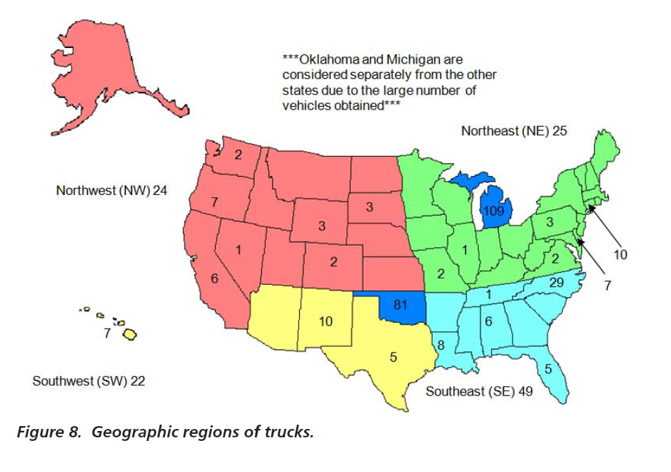
NCHRP 700 – A Comparison of AASHTO Bridge Load Rating Methods
Unique Vehicle Combinations Considered
Notes:
In 2011, an NCHRP Report was completed than analyzed how bridges would rate with the old Standard Specification Load Rating Method, and the newer MBE/LRFD Method. To be thorough, they took a look at the number of unique vehicles that the states had on file with previous load ratings, and evaluated them using both methods. When you look at it, you can see that some states are off the charts with how many different vehicles they have load rated. These are unique vehicles. Most states have simplified their truck configurations into Notional Loads so that they do not have to examine every unique category, but the states still seem to have a lot of Notional load vehicles.

Slide 34
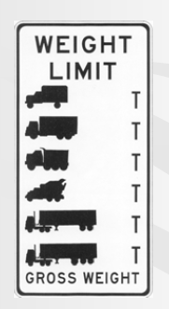
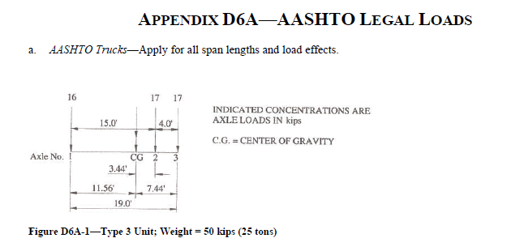
Loads
Legal Load
This second level rating provides a single safe load capacity (for a given truck configuration) applicable to AASHTO and State Legal Loads.
Notes:
There are a few live load conditions other than the design load, that may have to be incorporated into a load rating. AASHTO has legal loads that are used to evaluate the posted weight limits for bridges if they can not accommodate the HL-93 Design Load. The tricky part here is that some states have their own legal loads that actually exceed the AASHTO Design Load, and thus may be something that needs to be considered in the original design.

Slide 35
State Legal Loads
“Michigan legal loads are greater than the AASHTO legal loads that were used in the development of the AASHTO Standard Specifications for Highway Bridges and LRFD Codes.”
Notes:
It is things like this that make it tricky. On the national level, legal loads have very little meaning to us a producers. If we produce the structure to handle the AASHTO design load, than we know it will handle the AASHTO legal load. However, you get states that come along, and specify their own legal loads that exceed the National ones. Now these loads are required for load rating, and for the most part, will govern your design since a design to AASHTO HL-93 may not load rate to the state legal loads. This particular example is Michigan, but there are others out there. Report done in 2008.

Slide 36
State Legal Loads
“The operational ratings used by MDOT can be separated into 3 categories: Federal Ratings, Michigan Legal Loads and Overload Classification. In general, the Federal Ratings are for informational purposes only in order to provide FHWA with a common reference point for comparing structures within a state and across the country, and do not directly measure the operational capacity of a structure in Michigan ”
Notes:
Sticking with Michigan for one more slide. I felt like this sentence near the beginning of their report pretty much summed it up when it comes to states utilizing their own legal loads. “Federal Ratings are for informational purposes only”. An HL-93 design is meaningless.

Slide 37
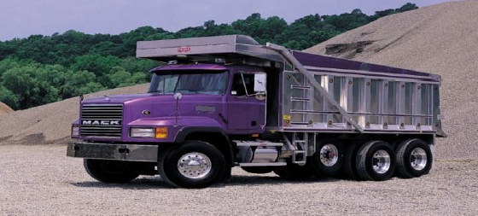
Loads
Specialized Hauling Vehicle
“Closely spaced multi-axle single unit trucks introduced by the trucking industry in the last decade”
Dump trucks, construction vehicles, solid waste trucks
Typically have 4 to 7 axles
Gross Weight < 80,000 lbs; single axle < 20,000 lbs; tandem axle < 34,000 lbs
Notes:
Let’s talk about vehicles we already know will exceed the legal loads on a national level. SHV’s – Specialized Hauling Vehicles seem to be all the rage lately. A relatively new development in load rating. The axle loads themselves are relatively light. However, the Feds have found that the combination of so many axles can sometimes induce loads that are higher than the HL-93 design load.

Slide 38
Notes:
So. What has happened is that the trucking industry has figured out ways to reduce their single axle loads to below the requirements, while getting a lot more total load on a vehicle.

Slide 39
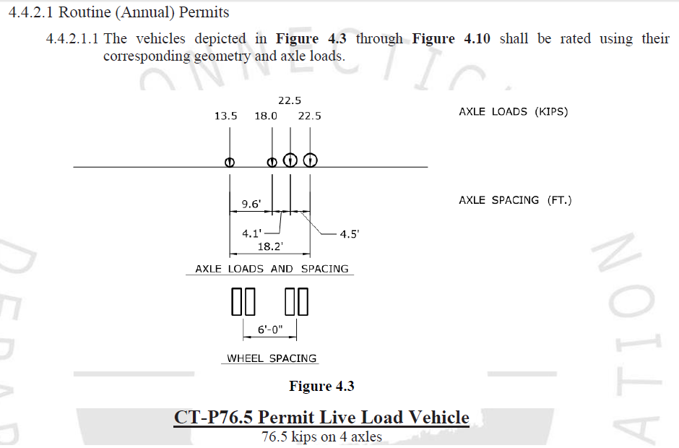
Loads
Permit Load
Permit load rating checks the safety and serviceability of bridges in the review of permit applications for the passage of vehicles above the legally established weight limitations.
Notes:
Permit Loads are loads that exceed the legal loads of the state. These loads are often done individually, and usually are not a requirement of the initial design, although they can be. Such as when states designate “Routine Permit Vehicles”.

Slide 40
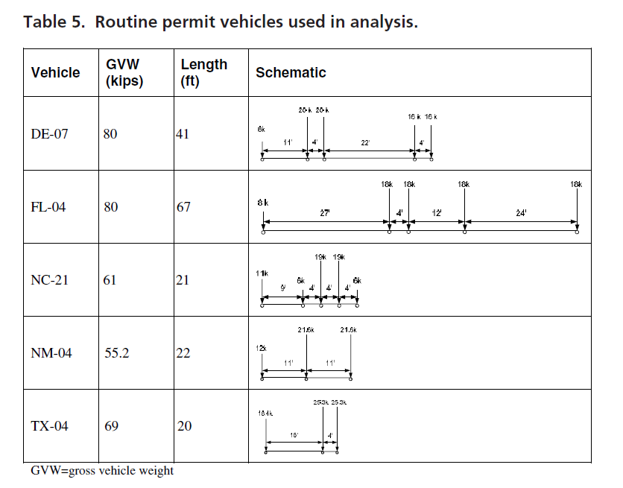
Permit Load Rating
Notes:
These are examples of “routine permit vehicles” that some states have.

Slide 41
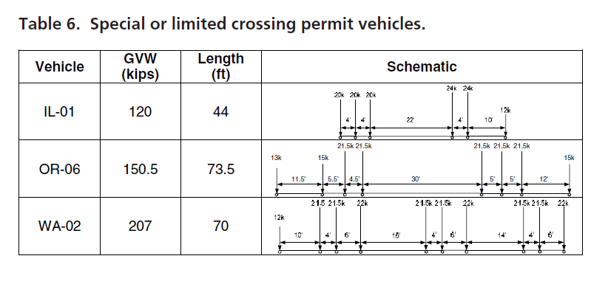
Permit Load Rating
NCHRP Report 700, “A Comparison of AASHTO Bridge Load Rating Methods”

Slide 42
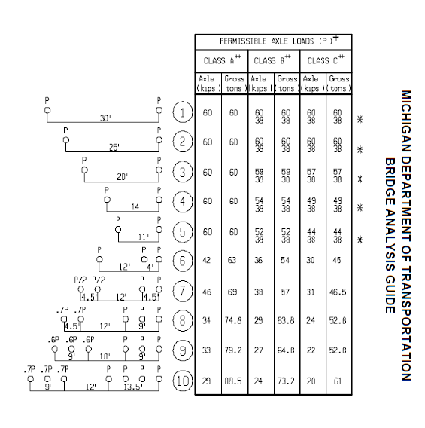
How Many Loads Do We Need to Consider?
Connecticut
Legal – 2
Permit – 10
Minnesota
Legal – 7
Permit – 3
Michigan
Legal – 28
Overload - 20
Notes:
I believe many states are relatively simple, and do not have a whole lot of specialized legal or permit vehicles. Those usually aren’t the ones I have to get involved with. However, some states can have quite extensive lists of extra vehicles to address. These numbers may not be entirely accurate.

Slide 43
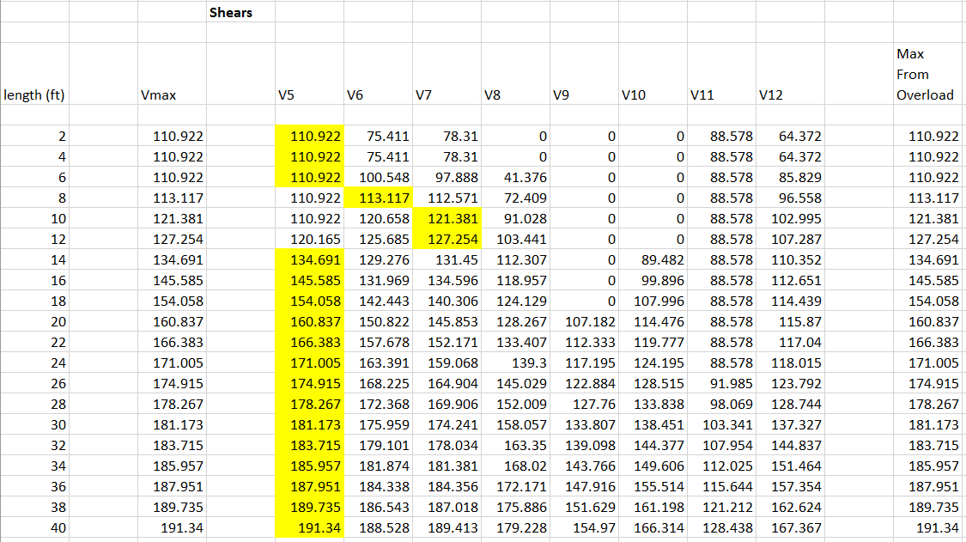
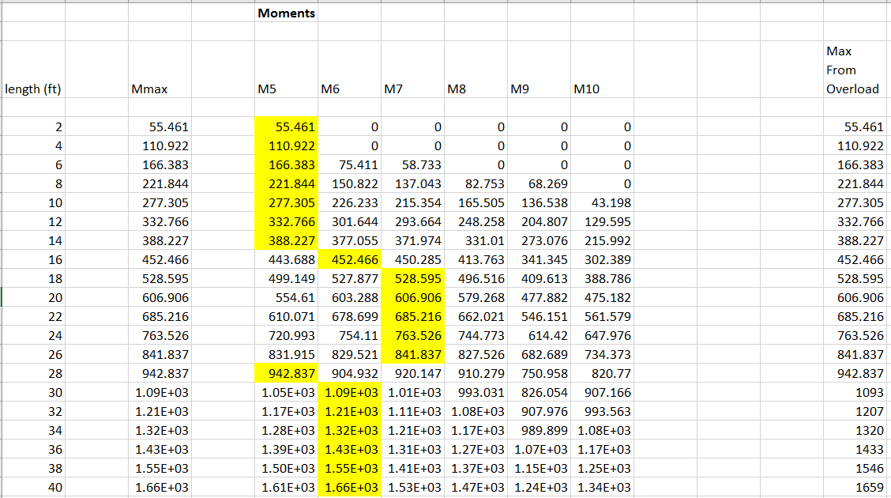
Different load cases
govern for different
spans and for
different limit states.
Notes:
When you have all of these load cases, you would sure like to pick one that would be the governing one for rating the structure, but it depends on the span of the structure, and may even depend on what limit state you are checking. One load condition may govern moment, while another load condition governs shear.

Slide 44
Notional Loads
The notional load is not a true representation of truck weights, but rather the force effects from the load (moments, shears, etc) are a true representation of the force effects due to actual trucks.
For the HL-93 Notional Load, the design truck or design tandem are the predominant load components for short and medium span bridges
For the HL-93 Notional Load, the lane load is the predominant load component for long span bridges
Lane loads need not be applied to culverts
Notes:
When you think of simplifying loads down to more simple applications, you think of Notional loads. Many of the loads used in design and load rating are notional loads, including the HL-93 design load. A notional load does not necessarily represent an actual truck configuration, but rather a load application that can develop moments and shears that will envelope the design forces you might expect to see from the vehicles on the road. The axle loads govern shorter spans, whereas a long span structure with a uniform load all the way across it may be more critical than several concentrated loads from axles.

Slide 45
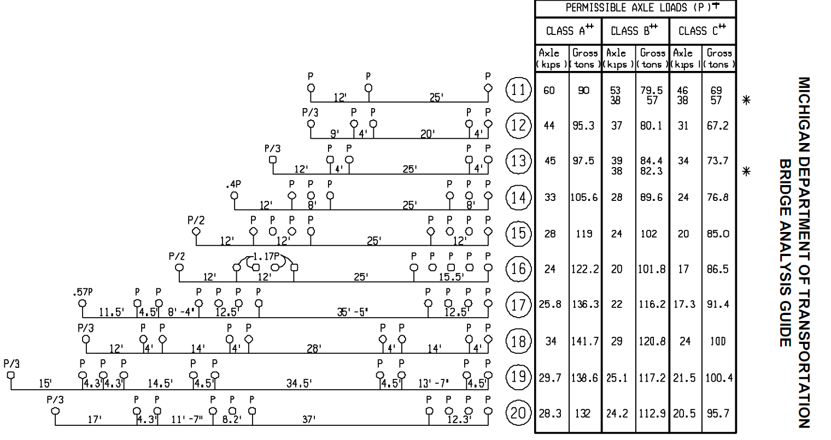
MDOT Overload Vehicles
Notes:
Sometimes, you will see extremely high single and tandem axle loads used to encapsulate a lot of different trucks that may exist. When you look at some states, such as Michigan, they will tell you that one of the reasons they have so many legal and overload/permit vehicles is to avoid having an extremely high single axle load that unduly punish shorter span bridges like culverts. So, in some ways, there is a benefit to taxpayers dollars by having several load conditions.

Slide 46
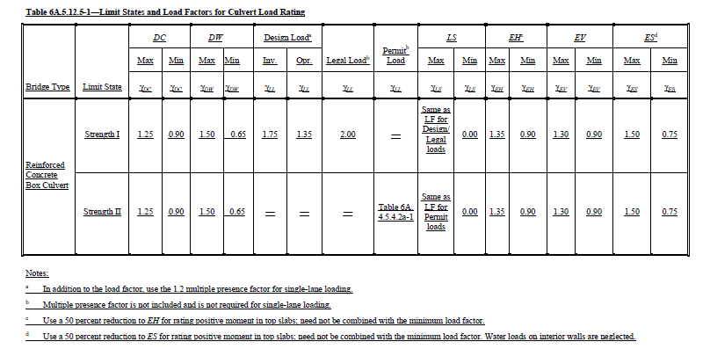
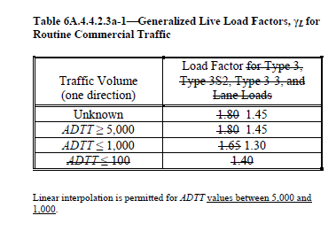
Load Factors – Design and Legal
Notes:
We already discussed the fact that the live load factors for the HL-93 are the same in load rating as they are for design. Legal load factors are slightly different at 2.0 for box culverts. With design live loads, you multiply the single lane design by a 1.2 multiple presence factor to get a total load increase of 2.1. The legal load factor of 2.0 does not include the multiple presence factor of 1.2, so the total live load increase is a little less than it is for design loads. However, they are not really doing us any favors, if you compare this factor to the values they allow elsewhere for legal loads. This really goes back to the live load suggestions from previous state and NCHRP research on live loads on box culverts. You will notice that this table specifically mentions box culverts, but I would assume you would use the same load factors for pipe, although pipe is not really addressed.

Slide 47
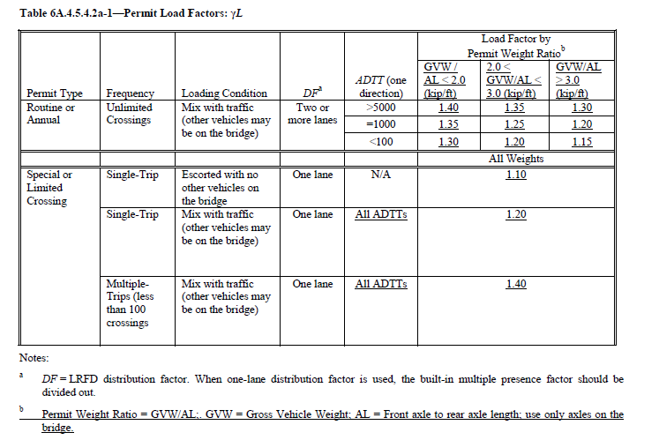
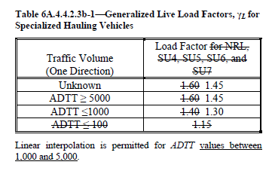
Load Factors – SHV’s and Permit Loads
Notes:
Permit loads allow lower live load factors. If you are issuing a permit, than you probably have better control over the load you are allowing on your highways, and thus a lower load factor would be acceptable.

Slide 48
Summary
Feds are taking a closer look at the load rating of culverts
The Feds are not asking that culvert spans be treated any differently than they have in the past…it still isn’t a bridge unless it is 20 feet or more.
Future load rating evaluations will be simpler if an initial load rating is supplied with the culvert
Notes:
The Feds have been taking a closer look at the rating of culverts lately. However, this only involves culverts that qualify as a bridge. The load rating of a lot of longer span culverts and multiple line culverts has been ignored in the past, and the Feds just wanted that to change. They do not want folks load rating anything new, just what they always should have been load rating. We can help the agencies out by performing a load rating along with our designs when asked, or when we know they should be load rated.

Slide 49
Summary
Some state DOTs may be looking to the producer to supply the initial load rating
Agencies can perform the analysis and structural capacity calculations in a variety of ways, which can complicate things
NCHRP 15-54, Proposed Modifications to AASHTO Culvert Load Rating Specifications
There are tools available to the load rating of box culverts….when needed.
Notes:
So….some agencies may look to you to perform the initial load rating on the product. You should welcome that, as long as they are willing to work with you to utilize the best design options available. The agencies can perform their designs in a variety of ways, which can often confuse things. Most people load rating culverts outside of our industry are bridge engineers that may not have a lot of understanding of culvert design. This is a big enough issue, that NCHRP has current research on this topic in an attempt to assist folks with culvert load ratings in the future. Even this is somewhat rocky, considering that they do not have any pipe engineers on the panel. There are a lot of load cases involved sometimes, so you will need software to help you get through this. The software does exist, such as ETCulvert.

Slide 50
The End

