Slide 1
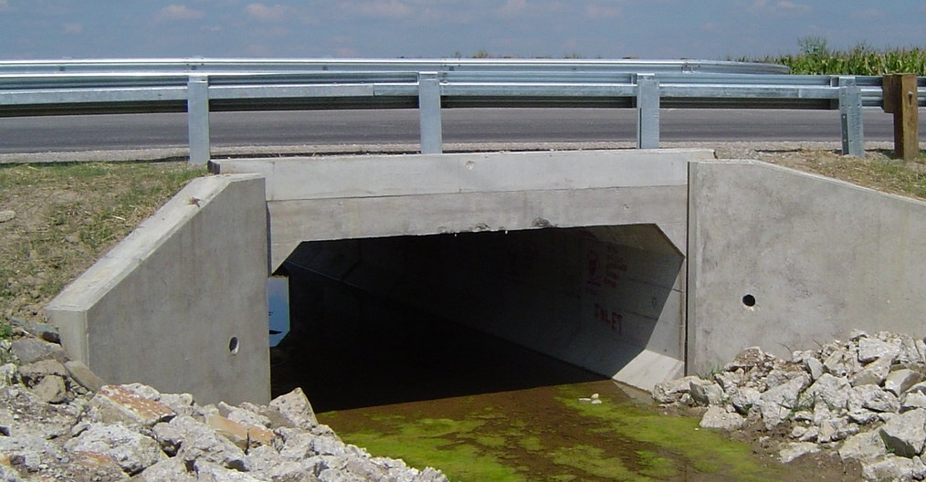
ETCulvert
Design and Rating of
Precast Culverts
ACPA Pipe School
February 14, 2014 Houston, TX
Roy Eriksson, P.E.
Brian Barngrover, P.E.

Slide 2
Roy Eriksson, PE
Roy L. Eriksson, P.E., is President of Eriksson Technologies, Inc. Based in Tampa with a branch office in Denver, Eriksson specializes in engineering software development and the rendering of consulting engineering services to the precast/prestressed concrete and highway bridge markets. Roy has over 25 yrs experience in structural engineering with extensive design and detailing experience in precast/pretensioned, CIP post-tensioned, spliced girder, cable-stayed and steel bridges.

Slide 3
Brian Barngrover, PE
Brian Barngrover, P.E., is Vice-President of Eriksson Technologies, Inc. Brian is in charge of software development at Eriksson Technologies. He has over 30 years experience in software development for the engineering community, along with experience in engineering design for the precast/prestressed concrete market. Brian began his career at a major precast/prestressed concrete fabricator gaining firsthand experience in all aspects of the design, detailing, and fabrication of precast concrete.

Slide 4
Agenda
8:00 am
10:35 am
11:30 am
Welcome
1. Overview of AASHTO LRFD
2. Culvert Design by LRFD
3. ETCulvert Overview
4. Interface Walk-thru
Break
5. Common Design Questions
6. Advanced Topics
7. Questions

Slide 5
Agenda
1. Overview of AASHTO LRFD
2. Culvert Design by LRFD
3. ETCulvert Overview
4. Interface Walk-thru
5. Common Design Questions
6. Advanced Topics
7. Questions

Slide 6
Objective of LRFD
To provide a comprehensive and consistent Load and Resistance Factor Design Specification.
This code was calibrated to obtain uniform reliability (a measure of safety) at the strength limit state for all materials
Notes:
15
2

Slide 7
Limit State
“A condition beyond which the bridge or component of the bridge fails to satisfy the provisions for which it was designed.”

Slide 8
Basis of LRFD Methodology
All limit states shall satisfy:
η Σ γ_{i} Q_{i} ≤ φ R_{n} = R_{r}
where:
η = Load modifier (= η_{D} η_{R} η_{I} > 0.95)
γ_{i} = Load factors
Q_{i} = Force effects
φ = Resistance factors
R_{n} = Nominal resistance
R_{r} = Factored resistance
Notes:
17
4
4

Slide 9
Ductility (η_{D} = Δu /Δy )
Property of component or connection which allows inelastic response
Varies (η_{D}= 0.95/1.05) for strength limit states only; η_{D}=1.00 for all other limit states
Components and Connections
Static and Dynamic
Notes:
19
7

Slide 10
Redundancy
Ability to support applied loads following the loss of a main load-carrying member
Varies (η_{R} = 0.95/1.05) for strength limit states only; η_{R}=1.00 for all other limit states
Failure-Critical (Nonredundant, η_{R}=1.05)
Nonfailure-Critical (Redundant, η_{R}=0.95)
Notes:
20
8

Slide 11
Operational Importance
Operation of structure critical or essential for social, survival or security reasons
Varies (η_{I} = 0.95/1.05) for strength and extreme event limit states only; η_{I}=1.00 for all other limit states
Consequential factor, not physical factor
Notes:
21
9

Slide 12
Limit States
Service: Stress, deformation, and cracking
Fatigue and Fracture: Limit cracking
Strength: Strength and stability
Extreme Event: Period of return greater than life of structure (e.g., crash barrier)

Slide 13
Service Limit States
I: Normal operational use of bridge.
II: Control yielding of steel structures and slip of connections due to live load.
III: Tension in prestressed concrete superstructures.
IV: Tension in prestressed concrete substructures.

Slide 14
Fatigue and Fracture Limit State
Loading combination for repetitive gravitational vehicular live load and dynamic responses under a single design truck.
Not for use in buried structures.

Slide 15
Strength Limit State
I: Normal operational use of bridge without wind load
II: Special design vehicles without wind
III: Wind velocity > 55 mph
IV: Very high dead load to live load ratios
V: Normal vehicular use of bridge with
55 mph wind velocity

Slide 16
Extreme Event Limit State
I: Earthquake
II: Vehicular and vessel collision

Slide 17
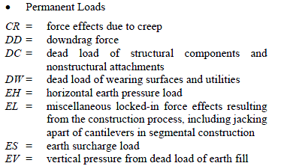

Loads

Slide 18
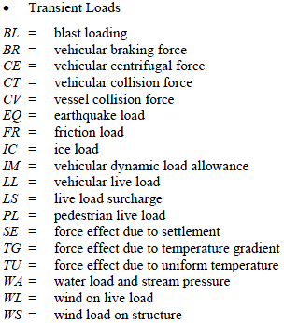
Loads

Slide 19
Loads
Permanent Loads
  Dead Loads: DC, DW
  Earth Loads: EH, EV, ES
Transient Loads
  Live Load
    Vehicular (e.g., HL93, permit, etc.): LL, IM, CV
    Live load surcharge: LS
  Water Load: WA

Slide 20
Limit States for Culverts
Strength
  Flexure of members (i.e., slabs, walls)
  Transverse Shear (i.e., slabs, walls)
Service
  Stresses in rebar (i.e., crack control)
  Deflections (single cells, top slab only)
Extreme Event
  Not in ETCulvert
  But might need to be assessed
Fatigue – Not for box culverts

Slide 21
Load Combinations
Recall that all limit states shall satisfy:
η Σ γ_{i} Q_{i} ≤ φ R_{n} = R_{r}
Notes:
17
4
4

Slide 22
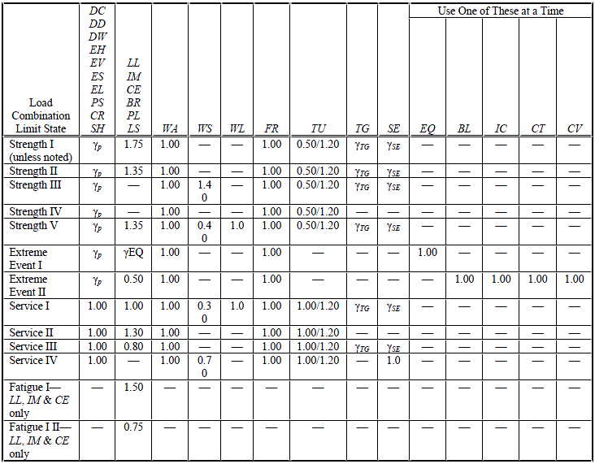
Load Combinations

Slide 23
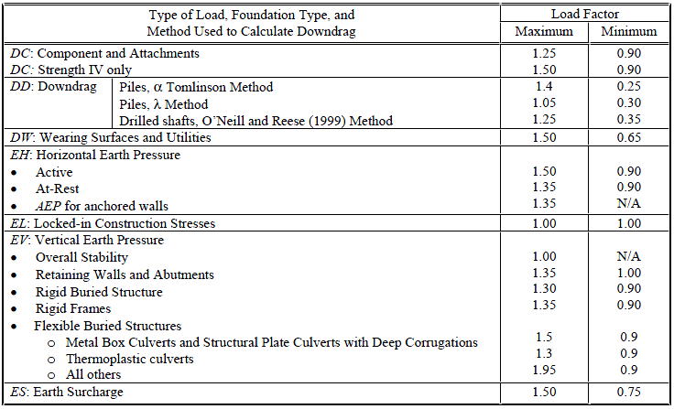
Load Combinations

Slide 24
Questions?

Slide 25
Agenda
1. Overview of AASHTO LRFD
2. Culvert Design by LRFD
3. ETCulvert Overview
4. Interface Walk-thru
5. Example Problem
6. Advanced Topics
7. Questions

Slide 26
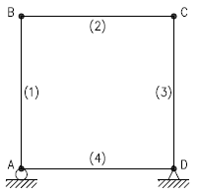
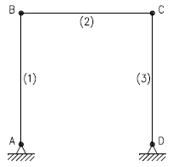
Structural Modeling
4-Sided, Single-Cell (Box)
3-Sided Frame

Slide 27
Structural Modeling
One-foot wide strip of culvert is used for structural analysis
Dead and live loads are distributed to this strip
All results are therefore on a per foot basis

Slide 28
Loads
Permanent Loads
  Self-Weight: DC
  Future Wearing: DW
  Earth Loads: EH, EV, ES
Transient Loads
  Live Load
    Vehicular (e.g., HL93, permit, etc.): LL, IM, CV
    Live load surcharge: LS
  Water Load: WA

Slide 29
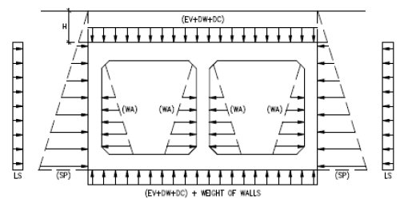
Loads

Slide 30
Structural Analysis
Structure analyzed using stiffness method (3D space frame)
Analysis performed using unfactored loads
Load combinations assembled based on applicable Limit States

Slide 31
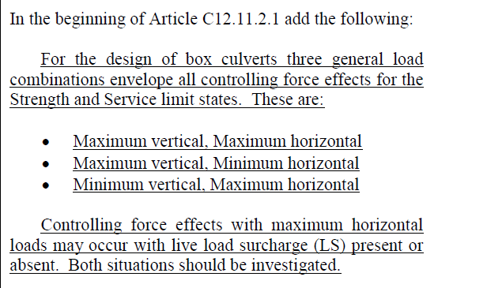
Structural Analysis
Addition to the 2013 AASHTO LRFD Bridge
Design Specifications
Notes:
The thing that makes evaluating and load rating box culverts somewhat unique versus superstructures is the combination of the application of vertical and horizontal loads to develop the controlling effects at various locations around the box. In addition to the changes approved for the MBE at July’s Bridge Engineers’ meeting, there was also an addition to the LRFD Bridge Design Specifications that may help you in determining the combinations of loads to use when addressing box culverts. This is not in print yet, but should be shortly.

Slide 32
Must Assess/Check:
Flexure
Shear
Stresses in Rebar
Deflections

Slide 33
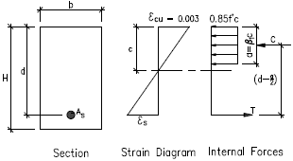
Flexural Strength
Must satisfy:
M_{r} = φM_{n} ≥ M_{u}
P-M interaction is optional
Minimum steel

Slide 34
Shear Strength
Must satisfy:
V_{r} = φV_{n} ≥ V_{u}
  Where: V_{n} = V_{c} + V_{s}

Slide 35
Computing V_{c}
Box Culverts
  Fills ≥ 2’
    Use 5.14.5.2 for slabs
    Use 5.8.3 for walls
      Thickness ≥ 16” or member is in tension: 5.8.3.4.2
      Thickness < 16”: 5.8.3.4.1
  Fills < 2’
    Use 5.8.3 for all members
3-Sided Structures
  For all fill depths:
    Use 5.8.3 for all members

Slide 36
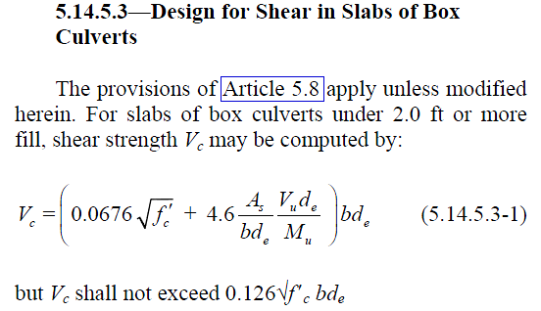
LRFD 5.14.5.3

Slide 37
5.8.3 Sectional Model
Two Methods to Compute Resistance:
5.8.3.4.1: Simplified Method (constant β)
5.8.3.4.2: General Procedure

Slide 38
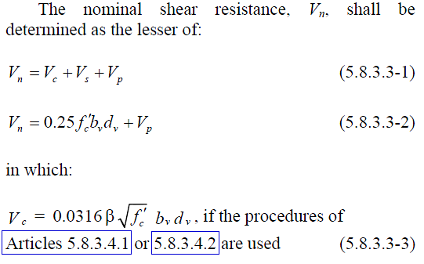

Simplified Method (constant β)

Slide 39
General Procedure
New approach to shear design
Modified Compression Field Theory (MCFT)
MCFT new to U.S., but used in Canada for a number of years
Based on variable-angle truss analogy
Assumes diagonally-cracked beam can be idealized as a truss at the strength limit state

Slide 40
Shear Design Procedure
Must assure:
φV_{n} = V_{r} > V_{u}
V_{n} = V_{c} + V_{s} + V_{p} < 0.25f’_{c}b_{v}d_{v} + V_{p}
where,
V_{c} = 0.0316β ( f_{c}’)^{0.5}b_{v}d_{v}
V_{s} = (A_{v}f_{y}/s)d_{v}cotθ
V_{p} = Vertical component of prestress force

Slide 41
Computation of V_{c}:
Direct Method
Appendix B5

Slide 42
Compute V_{c}: (App. B5)
1. Compute v/f_{c}’
2. Assume value of θ
3. Compute ε_{x}
4. Knowing v/f_{c}’ and ε_{x}, look up new value of θ
5. If new θ ≠ old θ, go to Step 3.
6. When value of θ converges, β is now known
7. Compute V_{c}

Slide 43
Concrete Shear Stress (v)
Shear stress on the concrete is computed by:

Slide 44
Tensile Steel Strain (ε_{x})
where,

Slide 45
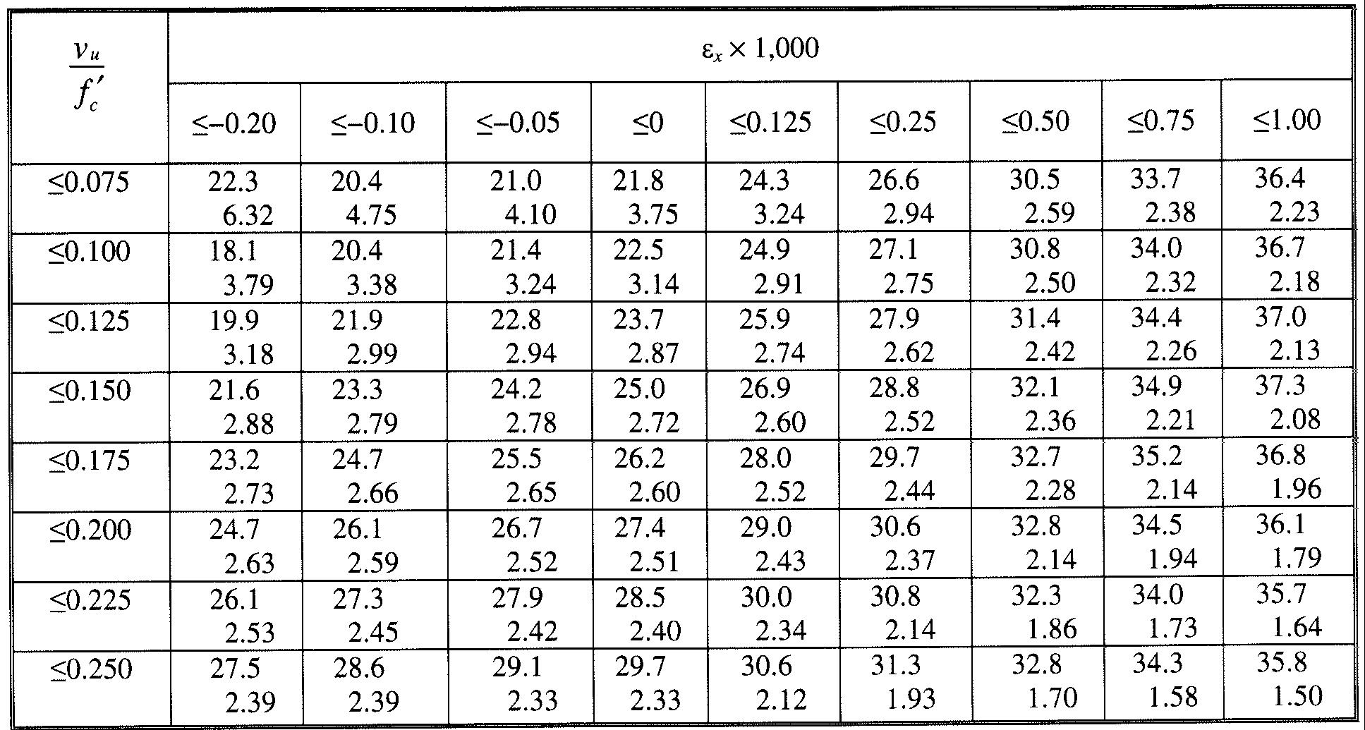
Table 5.8.3.4.2-1: Values of θ and β for Sections with Transverse Reinforcement.

Slide 46
Compute A_{v}
Knowing V_{c} , compute required V_{s}:
= V_{u}/φ - V_{c} - V_{p}
But, V_{s} = (A_{v}f_{y}d_{v}cotθ)/s
So, solve for required A_{v}
Check minimum A_{v}

Slide 47



Crack Control
LRFD 5.7.3.4

Slide 48
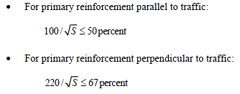
Distribution Reinforcement
LRFD 9.7.3.2

Slide 49
Shrinkage & Temperature
4-Sided (Boxes)
  LRFD 5.10.8
3-Sided
  LRFD 12.14.5.8

Slide 50
Deflections
Single-Cell, 3-Sided Frames
Top Slab
Limit:
  L/800
  L/1000
  Or user defined

Slide 51

Load Rating Culverts
Notes:
Even though box culverts represent a large quantity of what would be defined as a “bridge” per the AASHTO Manual for Bridge Evaluation, there has been very little guidance in the Manual on how to load rate these structures.

Slide 52
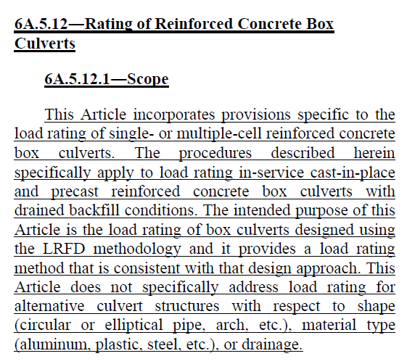
Load Rating of Buried Concrete Structures
Notes:
Section 6A.5.12 is now the section that address load rating of box culverts, both cast-in-place and precast. There are several pages associated with this section.

Slide 53
Overview of Load Rating Process
LRFR Philosophy
Rating Levels
  Design load rating
  Legal load rating
  Permit load rating
Rating Levels for HL-93
  Inventory
  Operating
General Load Rating Equations

Slide 54
Rating Levels
Design load rating
Legal load rating
Permit load rating

Slide 55
Rating Levels for HL-93
Inventory
  β = 3.5
  LL factor = 1.75
Operating
  β = 2.5
  LL factor = 1.35

Slide 56
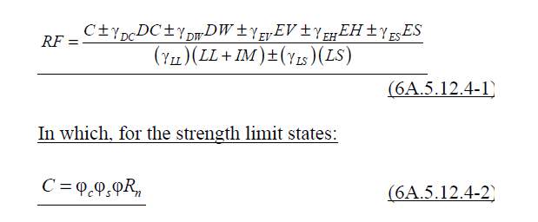
General Load Rating Equation
Notes:
This is the equation incorporated for load rating of box culverts. It follows the same philosophy as the load rating of bridges. What is perhaps somewhat different is the application of the lateral pressures to the buried structure. The last two terms in the numerator incorporate the horizontal earth load and any horizontal surcharge load. The horizontal surcharge load is anything excluding the live load surcharge load which is incorporated into the denominator of the equation, along with the vertical live load.
The MBE allows for the neglection of internal fluid load when performing load rating calculations.
The basic phi factor is for flexure or shear, depending on what you are evaluating. Phi s is the system factor, and Phi c is the condition factor.

Slide 57
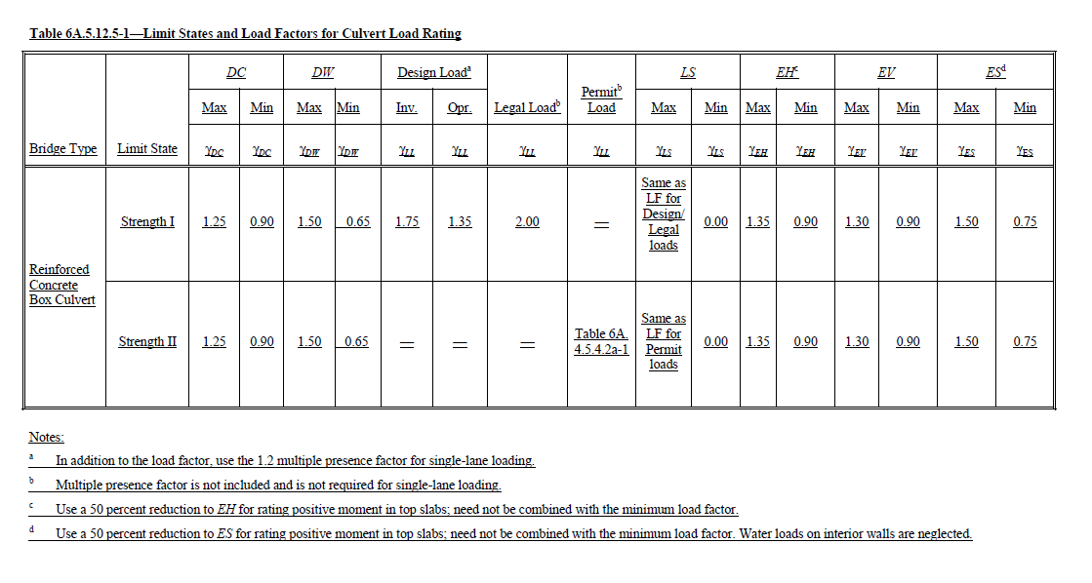
Limit States for Culvert Rating
Notes:
In terms of the load side of the equation, the load factors are given in Table 6A.5.12.5-1. The Design Load Factors are similar to what is required in the AASHTO LRFD Bridge Design Specifications. The Legal Load factor is a simple 2.0 value, negating the need to incorporate the 1.2 multiple presence factor. Please keep in mind that for Design Loads parallel to span, the box evaluation is based on a single lane with the single lane multiple presence factor.

Slide 58
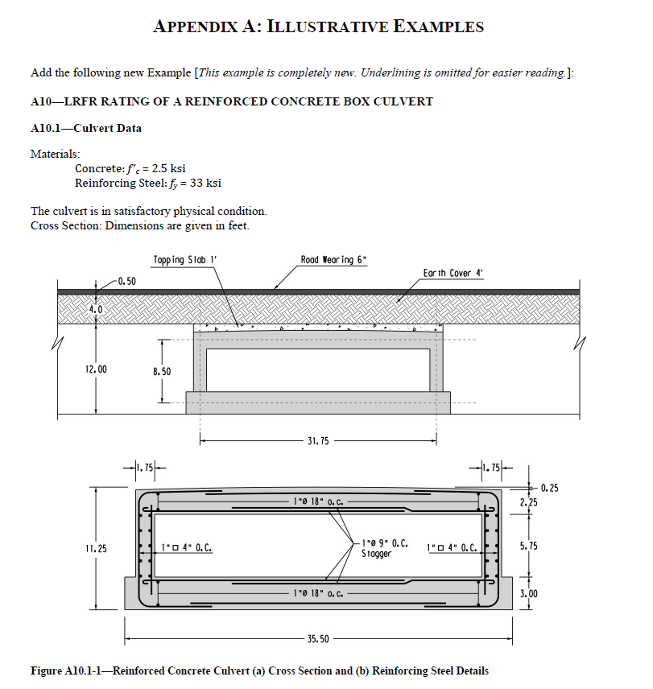
Load Rating Example in MBE
Notes:
In addition to the additions to the body of the MBE Manual, there has also been and addition to the Appendix of the Manual to incorporate an illustrative example for load rating of a box culvert. It is somewhat of a work in progress, but it may help you.

Slide 59
Questions?

Slide 60
Agenda
1. Overview of AASHTO LRFD
2. Culvert Design by LRFD
3. ETCulvert Overview
4. Interface Walk-thru
5. Common Design Questions
6. Advanced Topics
7. Questions

Slide 61
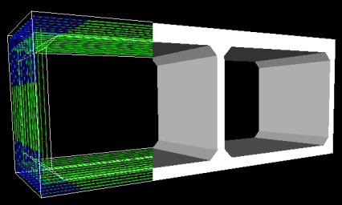
ETCulvert
Concrete Culvert Design in Accordance with AASHTO LRFD Specifications

Slide 62
ETCulvert Scope
Handles both 3- and 4-sided culverts
1 to 4 cells
Includes both US Customary and Metric (SI) Units
Supports:
  LRFD 5th Edition
  STND 17th Edition
  AREMA 2010 Edition

Slide 63
ETCulvert Scope
Allows use of either rebar or mesh
Optional shear steel
User-definable truck library
Automatic load ratings (LRFR or LFD)
Integrated 3D analysis engine

Slide 64
ETCulvert Scope
On-line help
Comprehensive user manual
Long-hand solutions
Detailed QC manual

Slide 65
ETCulvert Architecture
Comprehensive Menus
Windows standard toolbar
Four output views
All written in C#
.NET Framework

Slide 66
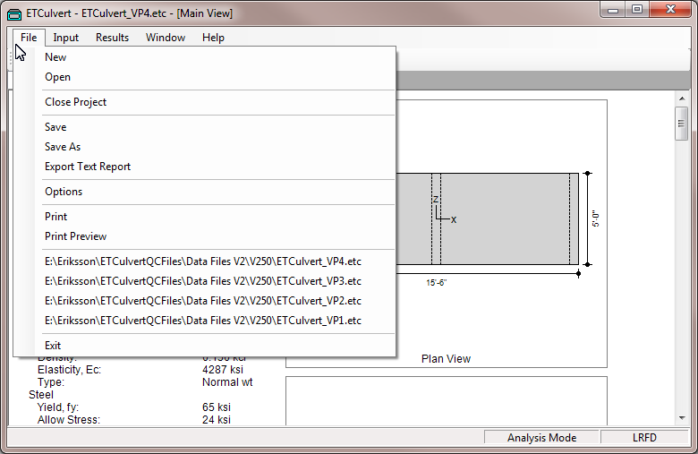
Comprehensive Menus
Standard Windows menus
All program options available through menus

Slide 67
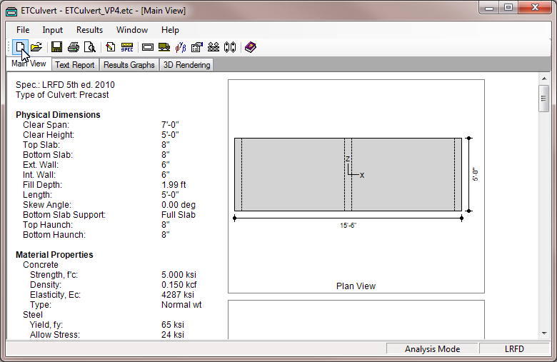
Windows Standard Toolbar

Slide 68
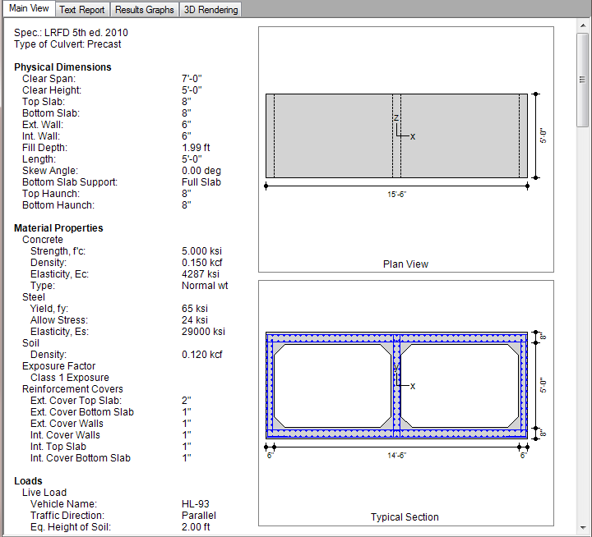
Main View

Slide 69
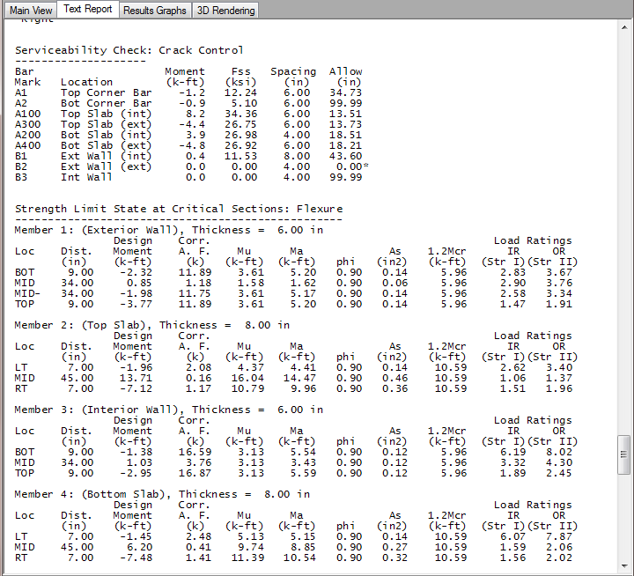
Text Report

Slide 70
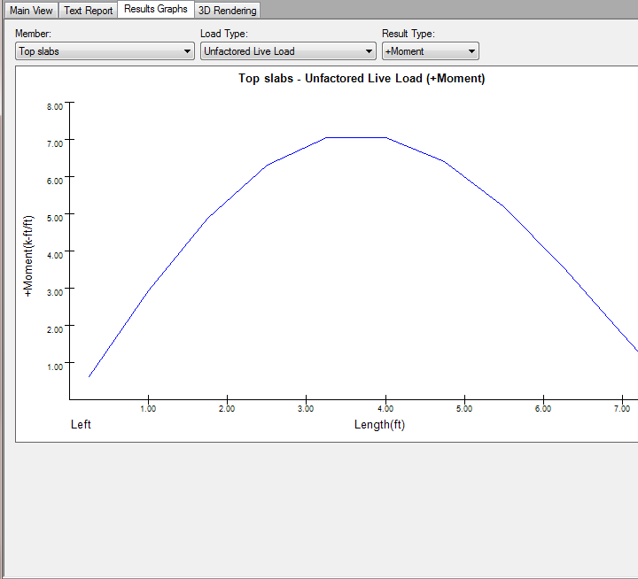
Results Graphs

Slide 71
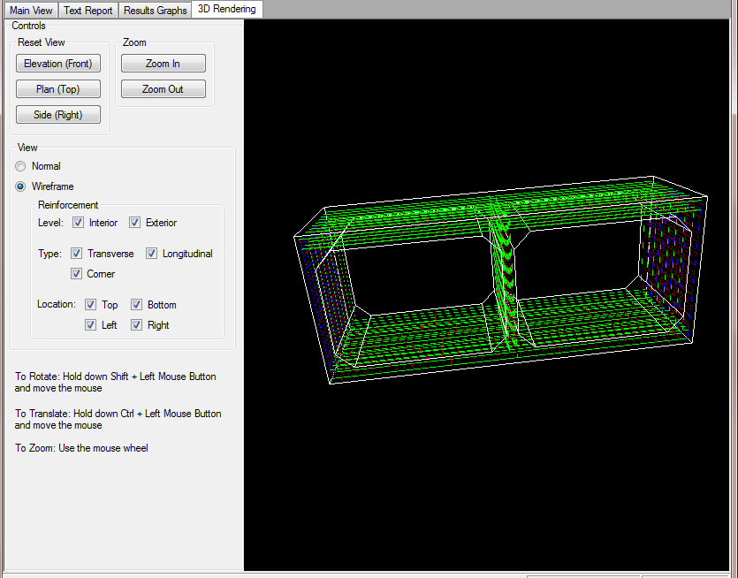
3D Rendering

Slide 72
Overview of the Design Process
ETCulvert has 2 Modes of Operation
  Design Mode
    Fully automatic parametric mode
    Member thicknesses calculated or fixed
    Generates size and spacing of reinforcement
  Analysis Mode
    All dimensions are under the control of the user
    All reinforcement is modifiable

Slide 73
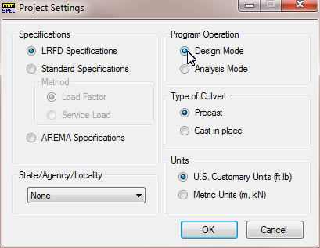
Design Mode
Automatically size members
Automatically select reinforcement

Slide 74

Analysis Mode
Assign member sizes
Change any reinforcement type/spacing

Slide 75
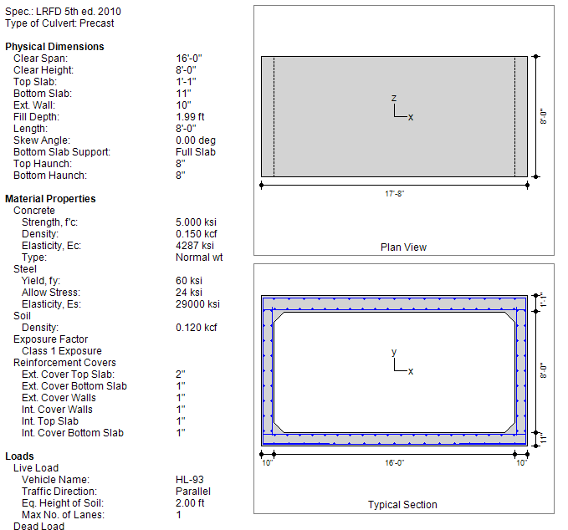
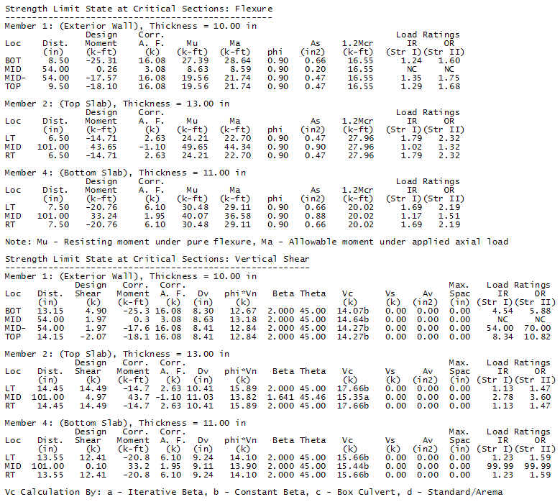
2D sketches and text report show current status of design
Notes:
Maine view shows the overall dimensions, along with a reinforcement schedule. Comprehensive text report shows the critical section tables.

Slide 76
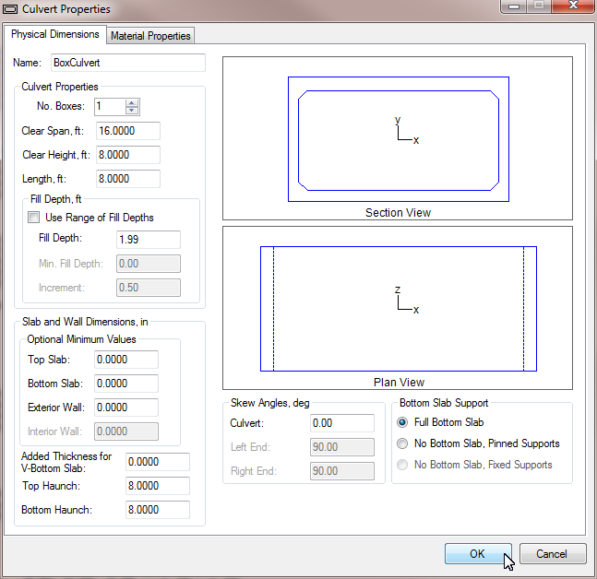
Parametric process continuously updates the design
Notes:
Every time you press the OK button, the design and all output displays are completely updated, in both Design and Analysis Modes.

Slide 77
Moving Load Analysis
Any number of axles
Variable axle spacing and weights
Patterned lane load
Combination of truck and lane load
Dedicated tandem load available

Slide 78
Reinforcement types supported
Mild rebar – Standard bar sizes
Mesh:
  Smooth
  Deformed

Slide 79
Critical Section Checks
Detailed tables for both flexural and shear critical sections
Can include effect of haunches in determining location of critical section
Automatically includes ratings, both inventory and operating

Slide 80
Questions?

