Slide 1
Evaluation and Rehabilitation of Installed Reinforced Concrete Pipe
Glenn Clayton, P.E., LEED AP
Illinois Concrete Pipe Association

Slide 2
Overview of “Evaluation and Rehabilitation of Installed Reinforced Concrete Pipe”
Design of RCP
Pre-Installation Visual Inspection of RCP
Installation Highlights
Post-Installation Visual Inspection of RCP
Condition Evaluation & Acceptance Criteria
Rehabilitation Methods

Slide 3
Factors Affecting Installed Condition
Strength
Hydraulics Joints Durability
Design
Manufacturing
Sanitary Sewers
Storm Sewers
Culverts
Construction

Slide 4
Why Study Design, Manufacture & Installation ?
Aid in forensic analysis of existing pipeline condition
Provide basis for ensuring proper functioning of new sewers and culverts

Slide 5
Design of Reinforced Concrete Pipe

Slide 6
“Unlike most reinforced concrete structures, reinforced concrete sewer and culvert pipes are designed to meet a specified cracking load, rather than a specified stress level in the reinforcing steel. This is both reasonable and conservative, since reinforced concrete pipe is tested in-plant in accordance with American Society of Materials (ASTM) specifications.”
Significance of Ultimate-Strength Requirements in Reinforced Concrete Pipe Design by Balaram K. Singh, P.E., Michigan Department of Transportation

Slide 7
“Reinforced concrete pipe is designed to crack. Cracking under load indicates that the tensile stresses have been transferred to the reinforcing steel. A 0.01-inch wide crack in a concrete pipe does not indicate structural distress and such pipe will perform as intended in the installed condition.”
Significance of Ultimate-Strength Requirements in Reinforced Concrete Pipe Design by Balaram K. Singh, P.E., Michigan Department of Transportation

Slide 8
ASTM C 76 RCP Classes
CLASS D-LOAD_{.01} D-LOAD_{ULT}
I 800 1200
II 1000 1500
III 1350 2000
IV 2000 3000
V 3000 3750

Slide 9
Pipe Joint Designs
Soil Tight
Watertight gravity
Watertight pressure

Slide 10
Pipe Joints
The most common joint sealants and fillers are:
  Bulk Mastic
  Preformed Flexible Joint Sealants (ASTM C 990)
  Rubber gaskets, attached and separate (ASTM C 443)
  External sealing bands (ASTM C 877)

Slide 11
Pre-Installation
Visual Inspection of RCP

Slide 12
Product Delivery
Concrete pipe should be inspected before unloading to ensure that no damage has occurred during shipment and handling.
Check for proper Diameter and for the proper gaskets and lubricant.
Each piece of pipe should be marked with the manufacturer’s name, date of manufacture and strength class.

Slide 13
Repairing Minor Damage
Repairing & patching of a concrete pipe is permitted by ASTM C76.
Occasional imperfections may be rectified, provided that the repairs are sound and properly finished and cured and the repaired product complies with IDOT specifications.

Slide 14
Installation Highlights

Slide 15
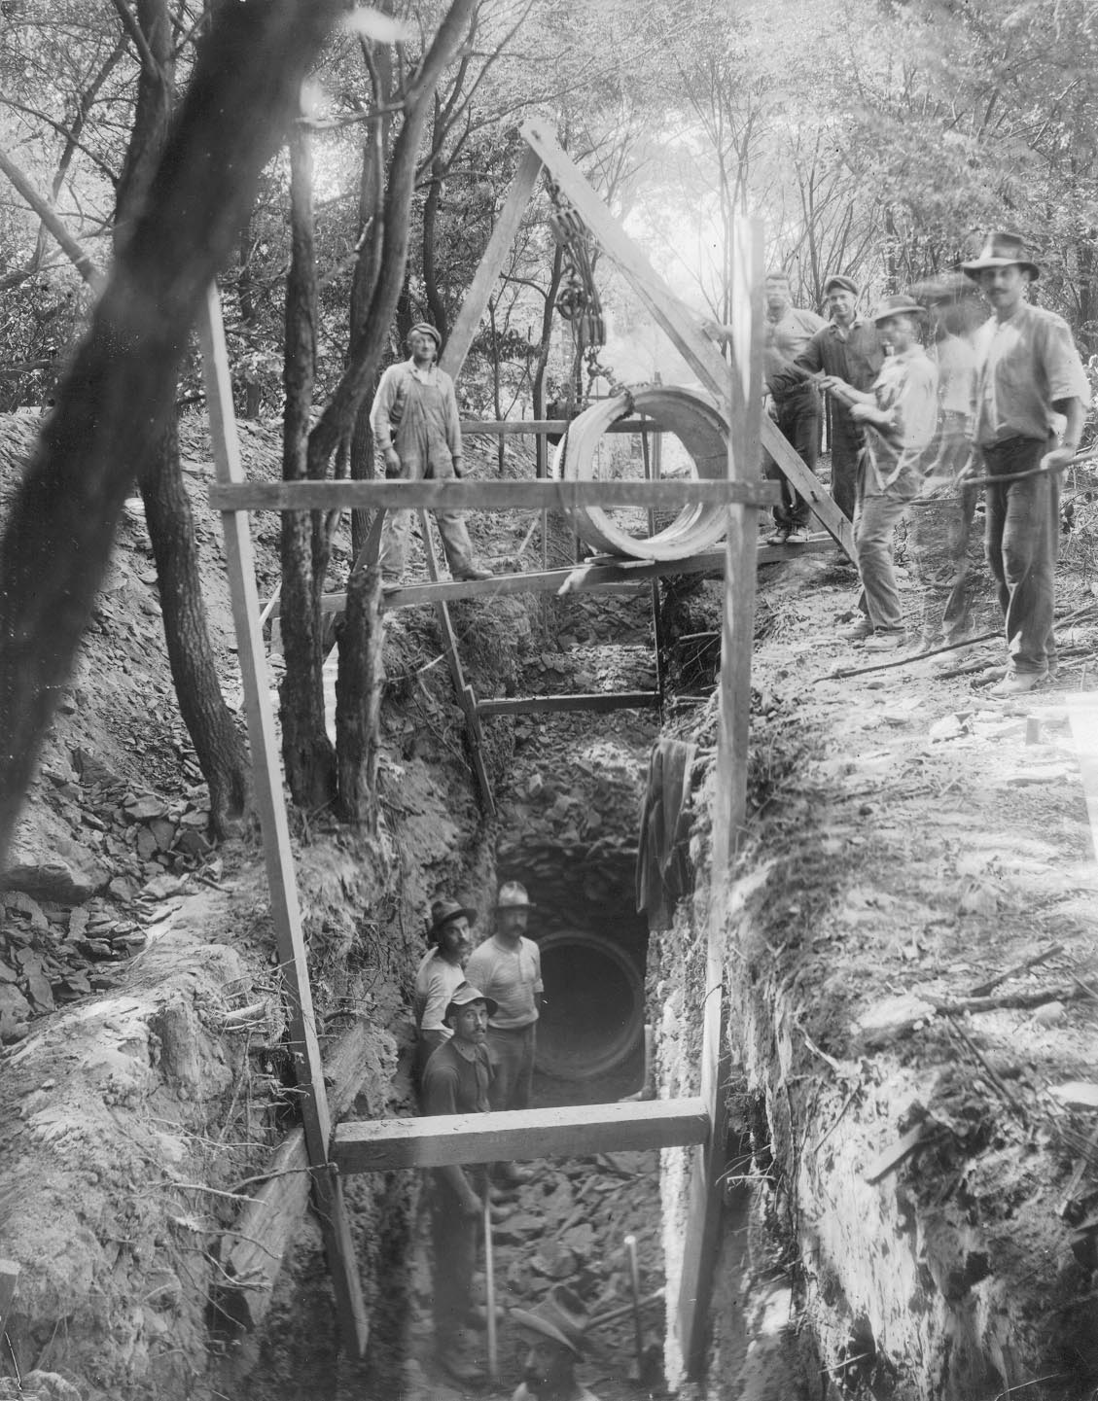

Slide 16
Importance of Proper Installation
Proper installation will ensure structural adequacy to carry the service loads.
Proper installation will ensure the system will have the design hydraulic capacity.
Proper installation will limit the potential for infiltration/exfiltration.

Slide 17
Installation Problems Leading to Poor Structural Performance
  Lack of adequate foundation preparation, or improper bedding material or bedding thickness may cause differential settlement and poor joint performance.
  Inadequate initial backfill compaction may cause stresses greater than anticipated in the design.
  Heavy compaction equipment used over the pipe without adequate clearance may damage the pipe.

Slide 18
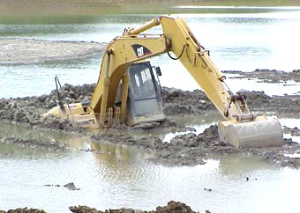

Slide 19
Installation Problems Leading to Poor Hydraulic Performance
  Lack of conformance to plan line & grade.
  Lack of adequate foundation preparation, or improper bedding material or bedding thickness may cause differential settlement and poor hydraulic performance.

Slide 20
Installation Problems Leading to Poor Joint Performance
Infiltration/Exfiltration
  Improper joining procedures may damage the bell and/or spigot, thereby reducing joint performance.
  Joint misalignment may prevent the gasket from properly sealing the joint.
  Improper gasket installation may cause the joint to leak.

Slide 21
Post-Installation
Inspection of RCP

Slide 22
Post Installation
Inspection & Testing
No post-installation testing or inspection is required by IDOT
No post-installation testing or inspection is required in the “Standard Specifications for Water & Sewer Main Construction in Illinois”
Notes:
No reason to do this in terms of checking for the structural adequacy of the pipe. This was already done by the three edge test and cylinder breaks. Could look at the pipe if we suspect construction damage.

Slide 23
Rationale for Lack of Post-Installation Testing Requirements
No known structural failures of RCP in storm sewer and culvert applications in Illinois
IDOT QC/QA Program Requirements, including pre-installation testing and visual inspection, ensure product conformance to the specifications
RCP’s inherent strength and rigidity result in little reliance on soil support for its load-carrying capacity

Slide 24
Condition Evaluation & Acceptance Criteria

Slide 25
More Common Condition Types
Joint defects-open joints, cracking
Cracking – longitudinal, circumferential, multiple

Slide 26
Less Common Condition Types
Spalling/Slabbing
Corrosion
Abrasion
Misalignment

Slide 27
Concerns of Cracking
Structural capacity
Corrosion potential
Infiltration/ exfiltration

Slide 28
Value of Videotaped Inspections
“Viewing a videotape of the inside of the pipe gives little or no information regarding concrete cover over the steel, strength, corrosion resistance, or life expectancy of the pipe. Pipe inspectors must be aware of the attributes of the pipe material, and cores must be taken to understand fully what they are seeing on tape.”
Positive Aging by Ken Kienow, P.E.

Slide 29
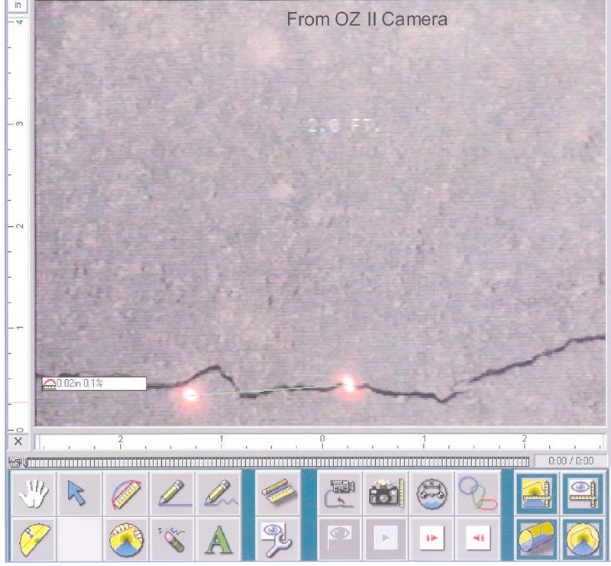
0.02” Crack

Slide 30
“ Some engineers insist that a crack in a concrete pipe in excess of 0.01 inch represents a failure or partial failure situation. Such a conclusion is utterly ridiculous and represents a disservice, not only to the concrete pipe industry, but taxpayers as well.”
Professor M. G. Spangler

Slide 31
“Cracks up to approximately 1/16th-inch will not permit corrosion except under the most adverse conditions.”
Professor M. G. Spangler

Slide 32
AASHTO Section 27
27.3.1
“Generally, in non-corrosive environments, cracks 0.10-inch or less in width are considered acceptable.”

Slide 33
ASCE 15-93 “Standard Practice for Direct Design of Buried Precast Concrete Pipe Using Standard Installations (SIDD)
Section C7.2.3
“Cracks are expected to occur in pipelines designed using this practice, just as cracks are expected in most reinforced-concrete structures that are subject to their design service loads. The 0.01-inch crack was originally selected arbitrarily as a test criterion and was then, and is now, not intended as an indication of structurally distressed or failed pipe in the installed condition.”

Slide 34
Ohio Department of Transportation
“In Ohio, the Department of Transportation has developed a post construction inspection standard for installed pipe, where there is evidence of cracking, that requires nothing to be done to a pipe with a crack up to 0.06-inch, due to the autogenous healing that is expected to occur.”

Slide 35
“The design crack is V-shaped in nature and is widest at the surface usually penetrating no further than the first reinforcing cage. Corrosion of the reinforcement is unlikely, providing the crack is not wide enough to permit circulation of moisture and replenishment of oxygen. Cracks in excess of 0.01-inch have been observed after several years with no evidence of corrosion.”
Significance of Ultimate-Strength Requirements in Reinforced Concrete Pipe Design by Balaram K. Singh, P.E., Michigan Department of Transportation

Slide 36
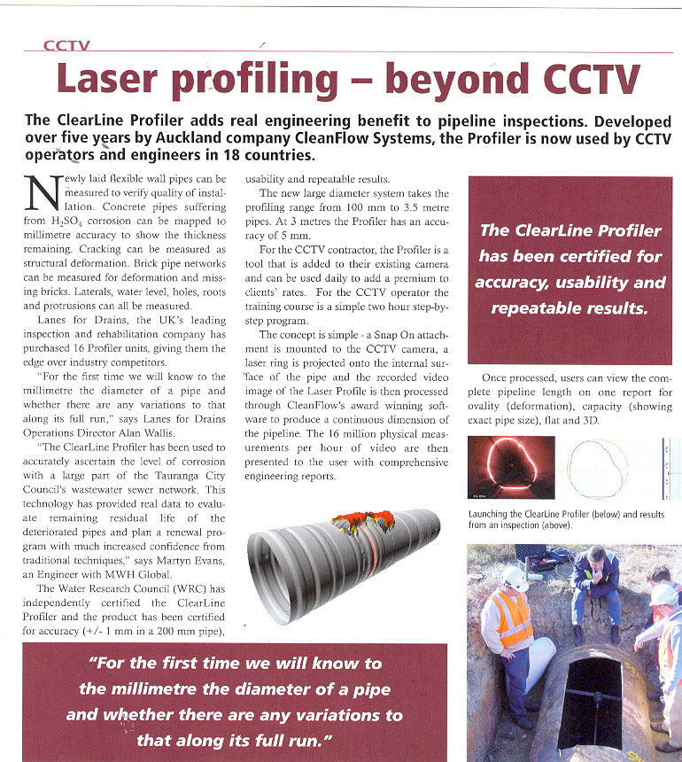

Slide 37
Diamond Bar Culvert Study
The “Diamond Bar Culvert” in California was installed under 80-feet of fill.
Although cracks up to 0.2-inch were observed, structural integrity was maintained.
It was deduced that similar results could be expected under similar operating conditions.

Slide 38
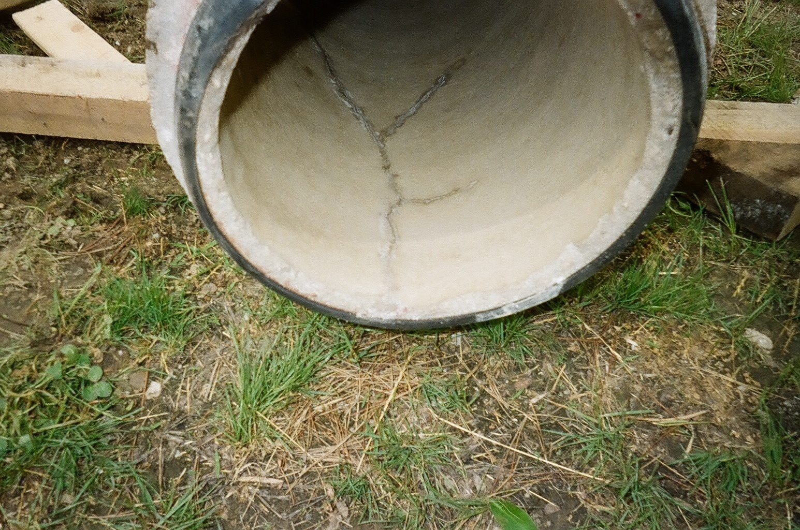

Slide 39
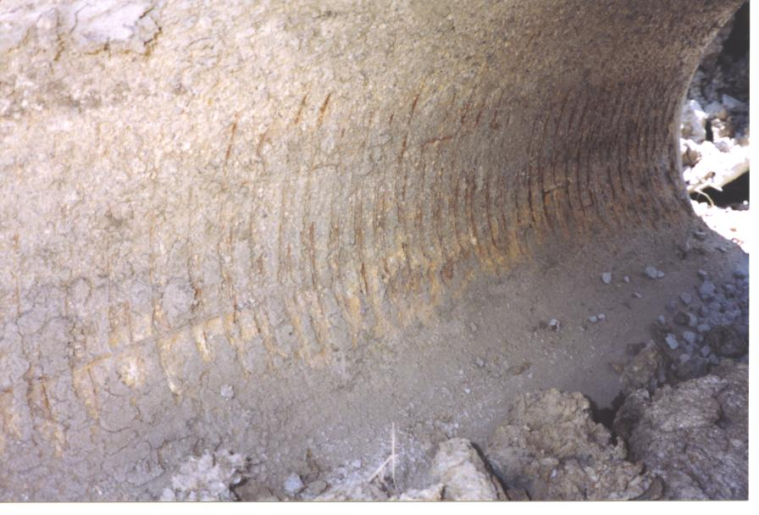

Slide 40
Autogenous Healing
The ability of concrete pipe to seal hairline or design cracks
Reaction between the free lime (calcium hydroxide) in the concrete and carbon dioxide, in the presence of moisture
Ca(OH)2 + CO2 = CaCO3 + H2O
This reaction forms calcium carbonate crystals that are a natural repair and ultimately impermeable.
Evidence of this process is a white crust on the surface of the concrete pipe in the area of a crack.

Slide 41
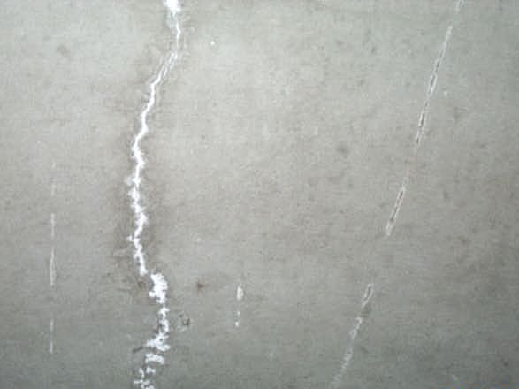

Slide 44
Why is Post-Installation
Inspection & Testing So Critical For Flexible Pipe?

Slide 45
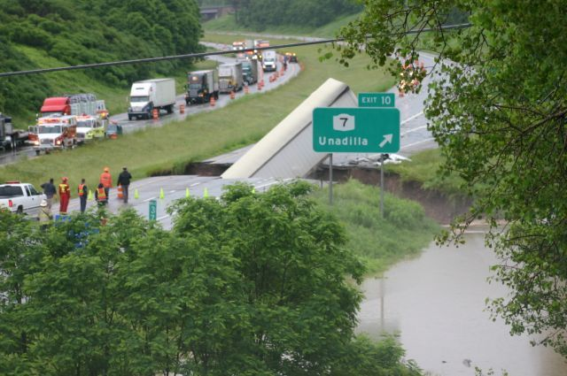

Slide 46
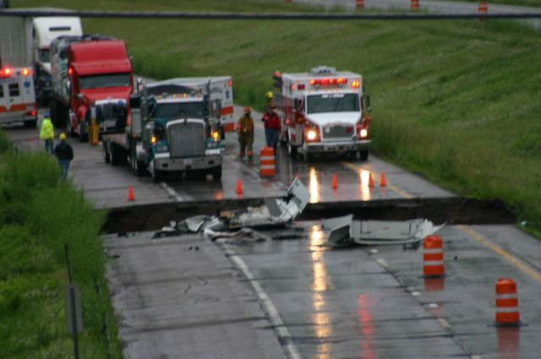

Slide 47
550.08 Deflection Testing for Storm Sewers
All PVC, PE, and CPP storm sewers shall be tested for deflection not less than 30 days after the pipe is installed and the backfill compacted. The testing shall be performed in the presence of the Engineer.

Slide 48
550.08 Deflection Testing for Storm Sewers
The outside diameter of the mandrel shall be 95 percent of the base inside diameter.
If the pipe is found to have a deflection greater than that specified, that pipe section shall be removed, replaced, and retested.

Slide 49
Rehabilitation Methods

Slide 50
RCP Rehabilitation Methods
Cured-in-place pipe liner (CIPP)
Sliplining
Centrifugally cast concrete mortar liner
Internal Joint Seals
Chemical Grouting

Slide 51
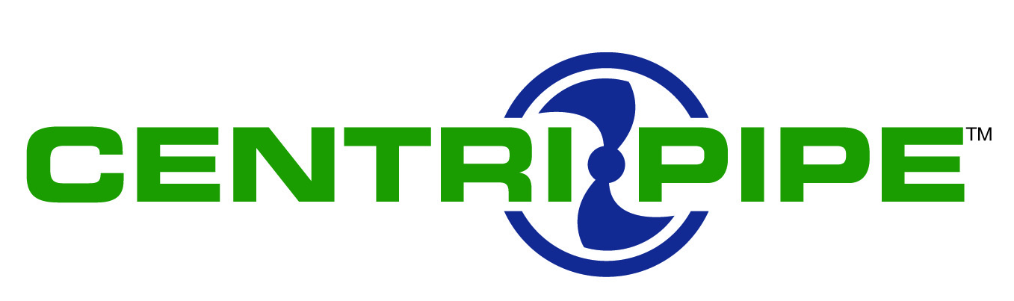
Pipe Lining by the Centrifugally Cast Concrete Pipe Lining Process
(Centri-Pipe)
APM/PERMAFORM

Slide 52
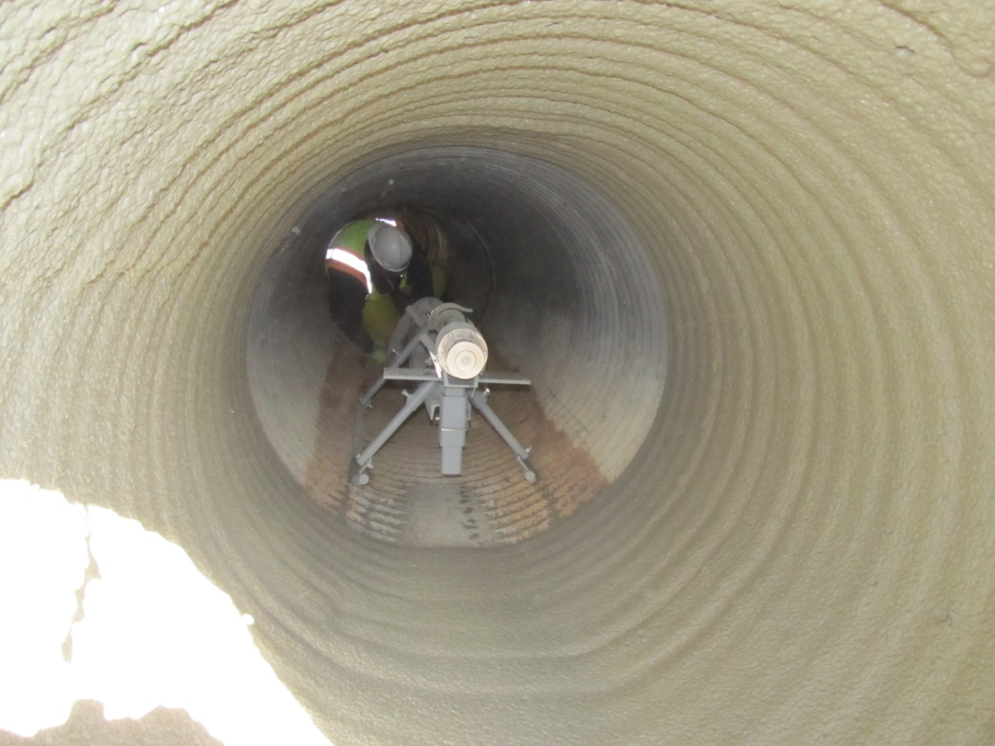
First Lining Pass

Slide 53
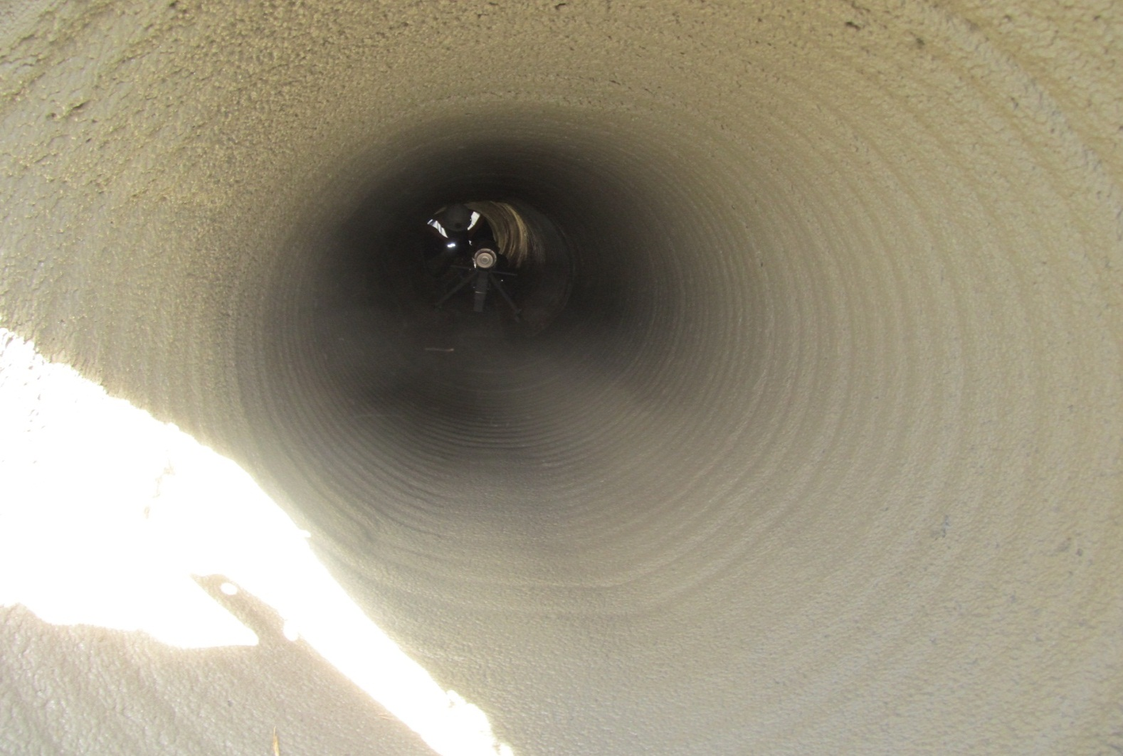
Finished Product

Slide 55
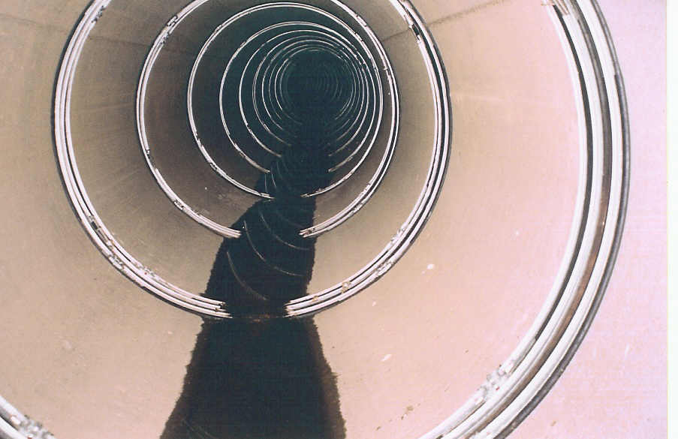

Slide 57
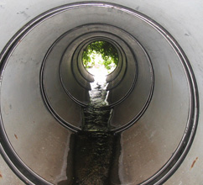

Slide 58
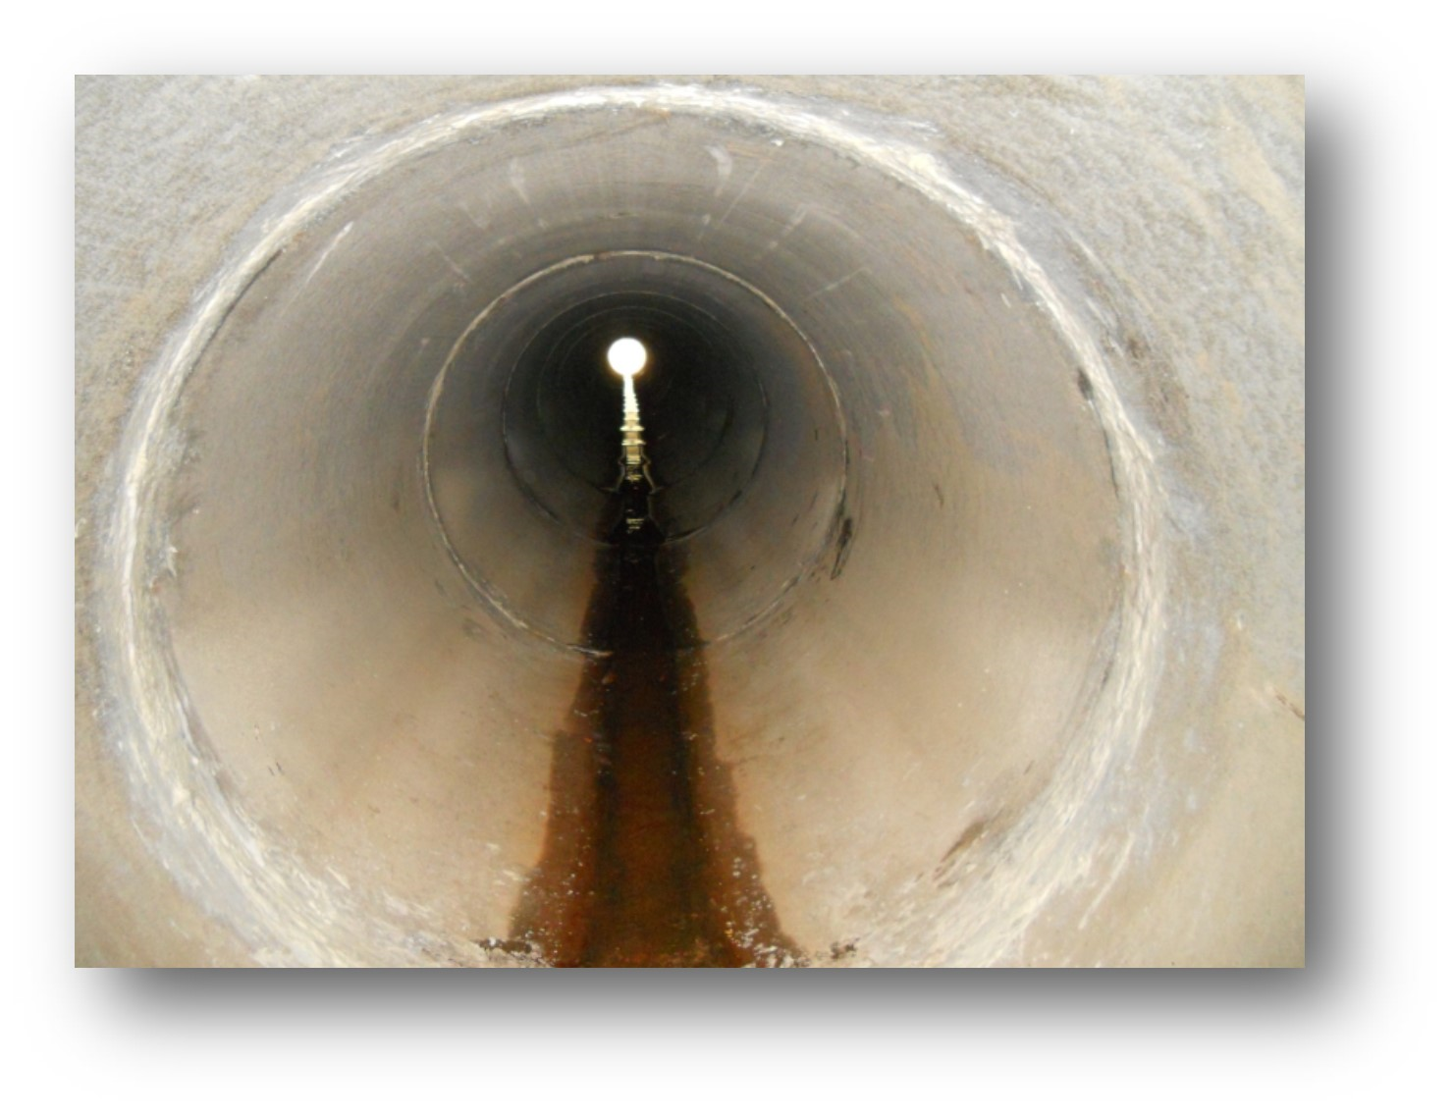

Slide 59
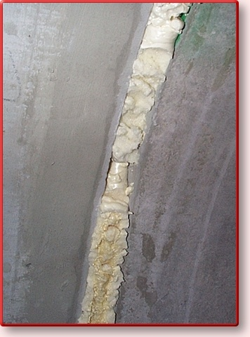

Slide 60
Further Information
http://illinois.concretepipe.org/
www.concretepipe.org
concretespecialtiescompany.com
www.countymaterials.com
www.welchbrothers.com
www.concretepipes.co.uk

Slide 61
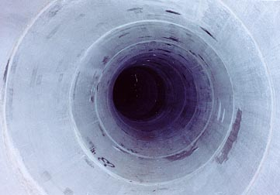
Thank You for Your Time and Attention.
QUESTIONS?

